Slide 1

Noida Institute of Engineering and Technology, Greater Noida
Statistical Technique-II
Module 2
Subject Name: Statistics and Probability
Subject Code: BAS0303N
Dr. Lokesh Chaudhary
Department of Mathematics
B Tech 4th Sem

Slide 2
Syllabus
Module 1: (Statistical Techniques-I)
Introduction: Measures of central tendency: Mean, Median, Mode, Standard deviation, Quartile deviation, Moment, Skewness, Kurtosis.
Module 2: (Statistical Techniques-II)
Curve Fitting, Method of least squares, fitting of straight lines, Fitting of second-degree parabola, Exponential curves, Correlation and Rank correlation, Linear regression, nonlinear regression and multiple linear regression.
Module 3: (Probability and Random Variable)
Random Variable: Definition of a Random Variable, Discrete Random Variable, Continuous Random Variable, Probability mass function, Probability Density Function, Distribution functions.
Multiple Random Variables: Joint density and distribution Function, Properties of Joint Distribution function, Marginal density Functions, Conditional Distribution and Density, Statistical Independence, Central Limit Theorem (Proof not expected).

Slide 3
Syllabus
Module 4: (Expectations and Probability Distribution)
Expectations of single Random Variable, Mean, Variance, Moment Generating Function, Binomial, Poisson, Normal, Exponential distribution.
Module 5: (Hypothesis Tests and Control Charts)
Testing a Hypothesis, Null hypothesis, Alternative hypothesis, Level of significance, Confidence limits, Test of significance of difference of means, Z-test, t-test and Chi-square test, F-test, One way ANOVA.
Statistical Quality Control (SQC), Control Charts, Control Charts for variables (Mean and Range Charts), Control Charts for Variables (p, np and C charts).

Slide 4
Branch Wise Application
Data Analysis
Artificial intelligence
Network and Traffic modeling

Slide 5
Course Objectives
The objective of this course is to familiarize the students with concepts of Probability and statistical techniques. It aims to equip the students with adequate Knowledge of statistics that will enable them in formulating Problems and solving problems analytically.
The students will learn:
Understand the concept of correlation, moments, skewness and kurtosis and curve fitting.
Apply the concept of hypothesis testing and statistical quality control to create control charts.
Remember the concept of probability to evaluate probability distributions.
Understand the concept of Mathematical Expectations and Probability Distribution.

Slide 6
Course Outcomes (CO2)
CO1: Apply the concept of moments, skewness and kurtosis in relevant field.
CO2: Apply the concept of correlation, regression and curve fitting with real world problems.
CO3: Apply the concept of probability and random variable.
CO4: Apply the concept of Mathematical Expectations and Probability Distribution in real life problems.
CO5: Apply the concept of hypothesis testing and statistical quality control to create control charts.

Slide 7
Prerequisite
Knowledge of Maths 1 B.Tech.
Knowledge of Maths 2 B.Tech.
Knowledge of Permutation and Combination.

Slide 8
Module Content(CO2)
Curve Fitting
Method of least squares
Fitting of straight lines
Fitting of second degree parabola
Exponential curves
Correlation and Rank correlation,
Linear regression
Nonlinear regression
Multiple linear regression

Slide 9
Module Objectives (CO2)
The objective of this course is to familiarize the engineers with concept of Statistical techniques.
It aims to show case the students with standard concepts and tools from B.Tech to deal with advanced level of mathematics and applications that would be essential for their disciplines.

Slide 10
Topic objectives (CO2)
Curve Fitting
The objective of curve fitting is to find the parameters of a mathematical model that describes a set of data in a way that minimizes the difference between the model and the data.

Slide 11
Curve Fitting (CO2)
Curve Fitting :Curve fitting means an exact relationship between two variables by algebraic equation. It enables us to represent the relationship between two variables by simple algebraic expressions e.g. polynomials, exponential or logarithmic functions. .It is also used to estimate the values of one variable corresponding to the specified values of other variables.
Method of Least Squares: Method of least squares provides a unique set of values to the constants and hence suggests a curve of best fit to the given data.

Slide 12
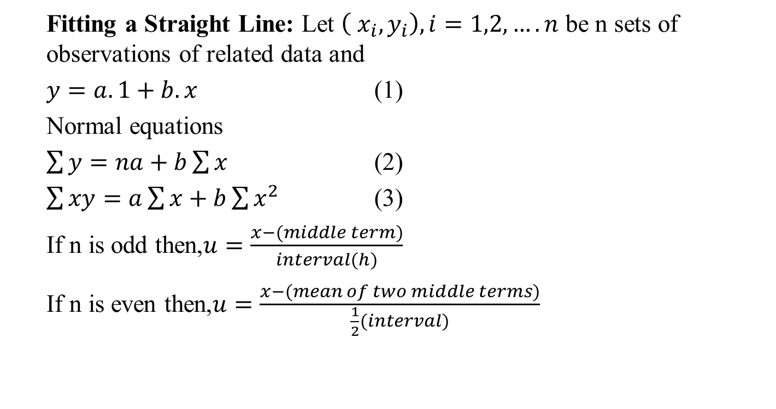
Curve Fitting (CO2)
Fitting a Straight Line: Let $\left( x_{i},y_{i}\right),i=1,2,….n$ be n sets of observations of related data and
$y=a.1+b.x$ (1)
Normal equations
$\sum{y}=na+b\sum{x}$ (2)
$\sum{xy}=a\sum{x}+b\sum{x^{2}}$ (3)
If n is odd then,$u=\frac{x−(middle term)}{interval(h)}$
If n is even then,$u=\frac{x−(mean of two middle terms)}{\frac{1}{2}(interval)}$

Slide 13
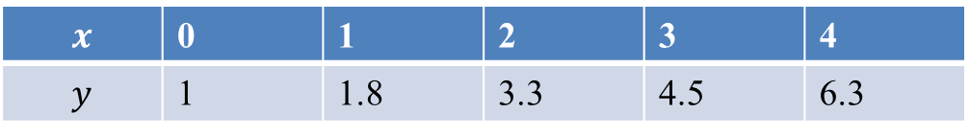
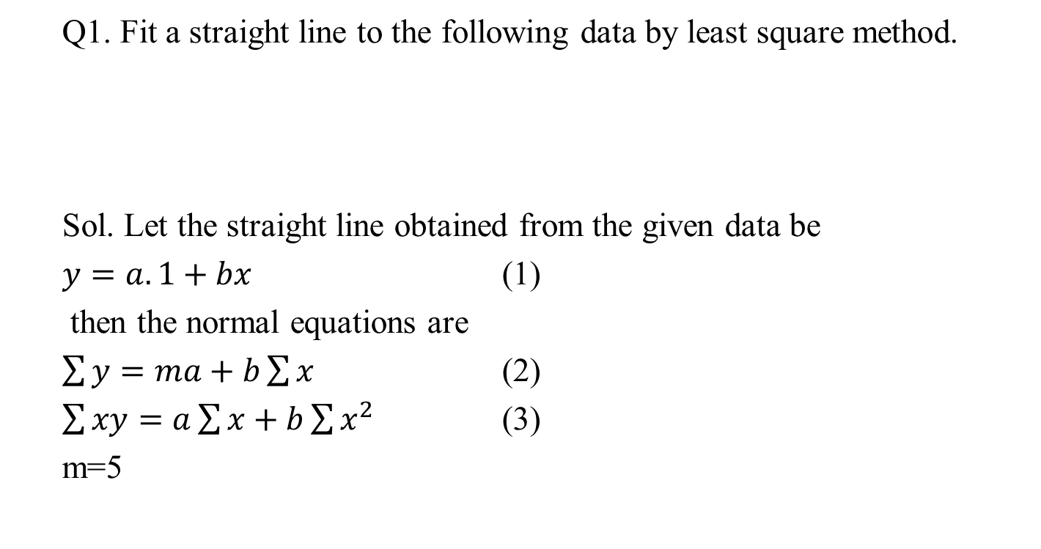
Curve Fitting (CO2)
Q1. Fit a straight line to the following data by least square method.
Sol. Let the straight line obtained from the given data be
$y=a.1+bx$ (1)
then the normal equations are
$\sum{y}=ma+b\sum{x}$ (2)
$\sum{xy}=a\sum{x}+b\sum{x^{2}}$ (3)
m=5
$$x$$ | 0 | 1 | 2 | 3 | 4
$$y$$ | 1 | 1.8 | 3.3 | 4.5 | 6.3

Slide 14
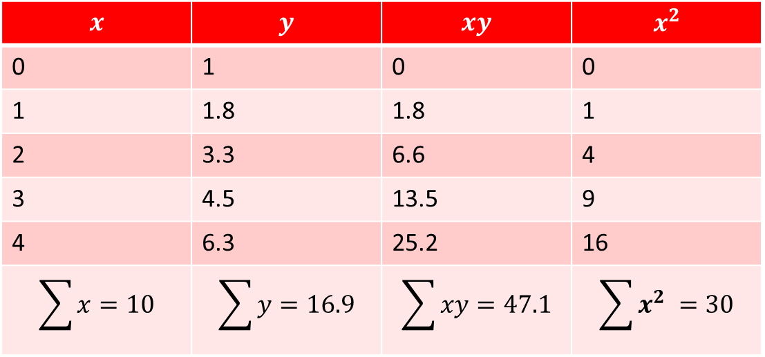
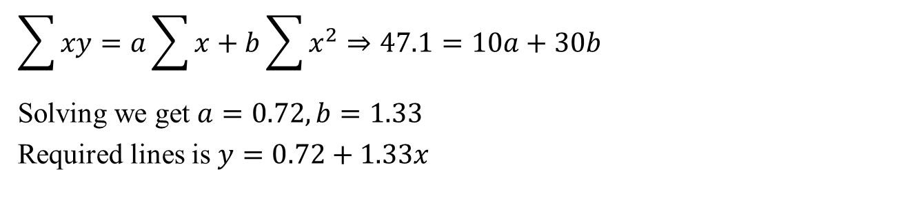
Curve Fitting (CO2)
$$x$$ | $$y$$ | $$xy$$ | $$x^{2}$$
0 | 1 | 0 | 0
1 | 1.8 | 1.8 | 1
2 | 3.3 | 6.6 | 4
3 | 4.5 | 13.5 | 9
4 | 6.3 | 25.2 | 16
$$\sum{x}=10$$ | $$\sum{y}=16.9$$ | $$\sum{xy}=47.1$$ | $$\sum{x^{2} }=30$$
$$\sum{xy}=a\sum{x}+b\sum{x^{2}}⇒47.1=10a+30b$$
Solving we get $a=0.72,b=1.33$
Required lines is $y=0.72+1.33x$

Slide 15
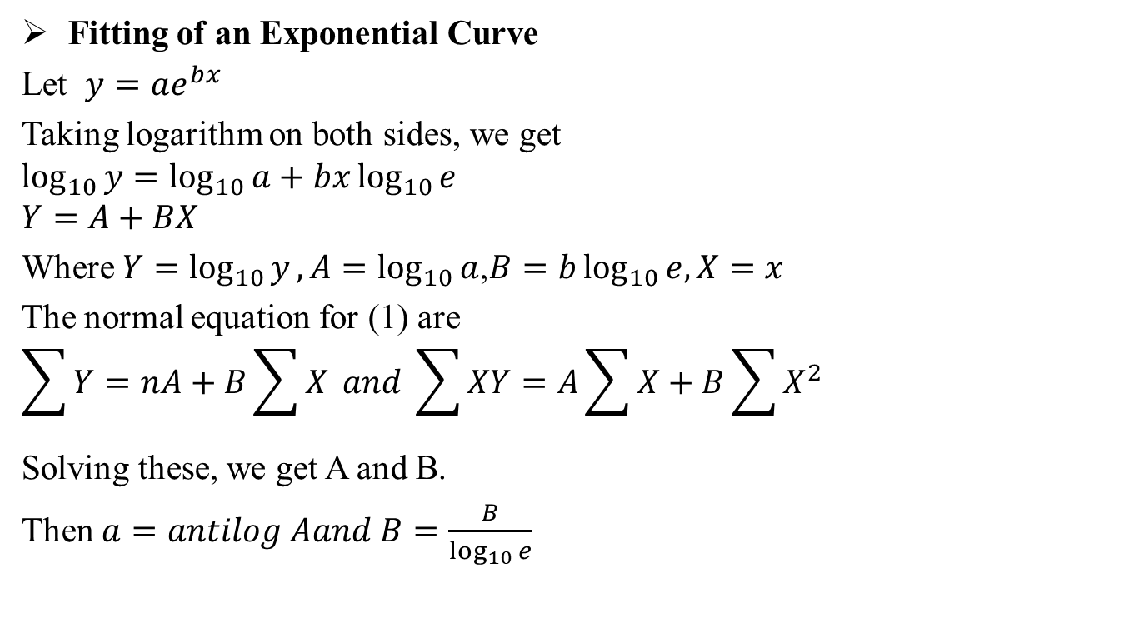
Curve Fitting (CO2)
Fitting of an Exponential Curve
Let $y=ae^{bx}$
Taking logarithm on both sides, we get
$$\log_{10}{y}=\log_{10}{a}+bx\log_{10}{e}$$
$$Y=A+BX$$
Where $Y=$ $\log_{10}{y},A=\log_{10}{a}$,$B=b\log_{10}{e,X=x}$
The normal equation for (1) are
$$\sum{Y}=nA+B\sum{X} and \sum{XY}=A\sum{X}+B\sum{X^{2}}$$
Solving these, we get A and B.
Then $a=antilog Aand B=\frac{B}{\log_{10}{e}}$

Slide 16
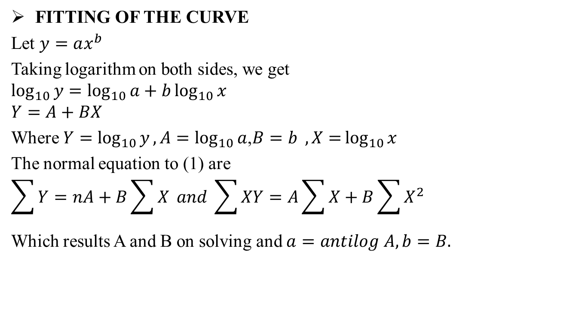
Curve Fitting (CO2)
FITTING OF THE CURVE
Let $y=ax^{b}$
Taking logarithm on both sides, we get
$$\log_{10}{y}=\log_{10}{a}+b\log_{10}{x}$$
$$Y=A+BX$$
Where $Y=$ $\log_{10}{y},A=\log_{10}{a}$,$B=b{,X=}\log_{10}{x}$
The normal equation to (1) are
$$\sum{Y}=nA+B\sum{X} and \sum{XY}=A\sum{X}+B\sum{X^{2}}$$
Which results A and B on solving and $a=antilog A,b=B.$

Slide 17
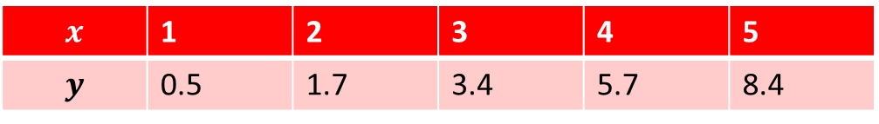
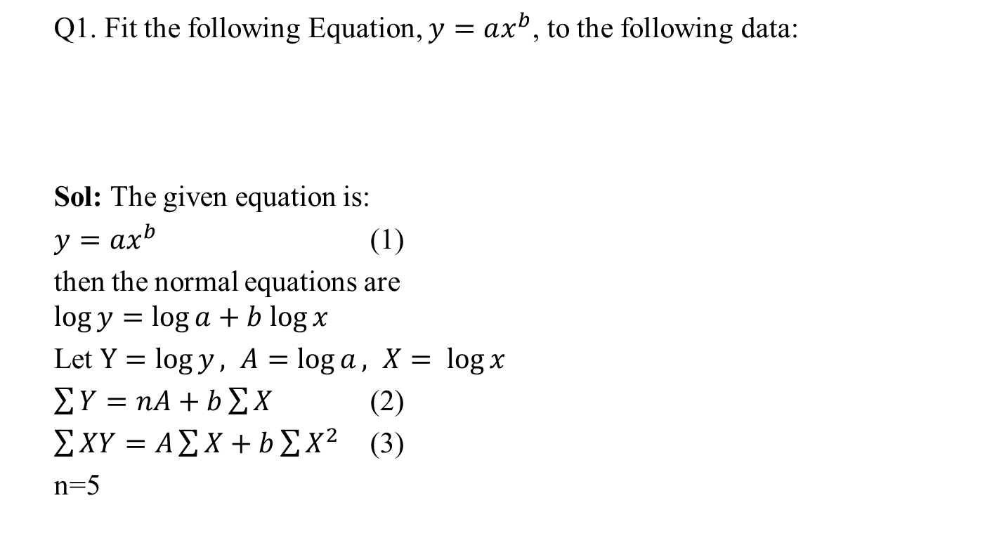
Curve Fitting (CO2)
Q1. Fit the following Equation, $y=ax^{b}$, to the following data:
Sol: The given equation is:
$y=ax^{b}$ (1)
then the normal equations are
$$\log{y}=\log{a}+b log⁡x$$
Let $Y=\log{y}, A=\log{a}, X= log⁡x$
$\sum{Y}=nA+b\sum{X}$ (2)
$\sum{XY}=A\sum{X}+b\sum{X^{2}}$ (3)
n=5
$$x$$ | 1 | 2 | 3 | 4 | 5
$$y$$ | 0.5 | 1.7 | 3.4 | 5.7 | 8.4

Slide 18
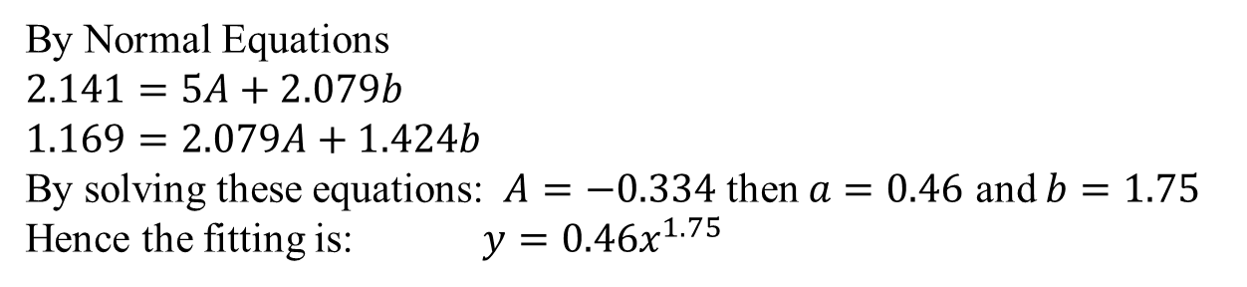
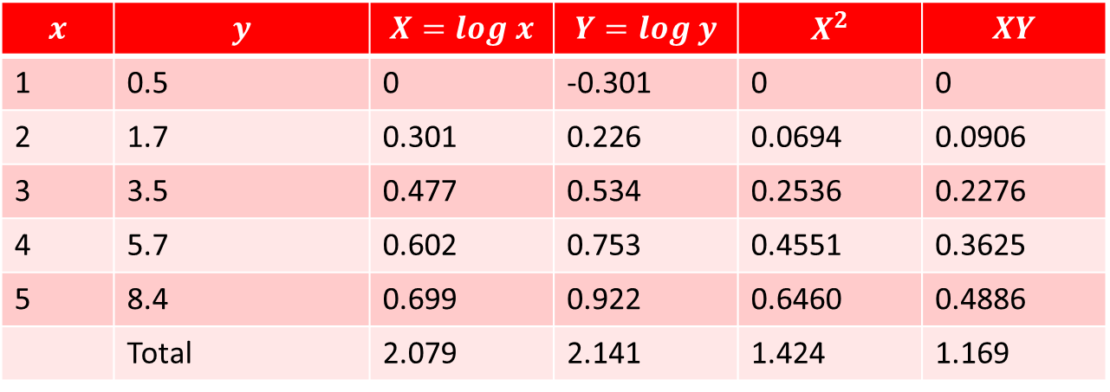
Curve Fitting (CO2)
$$x$$ | $$y$$ | $$X=log x$$ | $$Y=log y$$ | $$X^{2}$$ | $$XY$$
1 | 0.5 | 0 | -0.301 | 0 | 0
2 | 1.7 | 0.301 | 0.226 | 0.0694 | 0.0906
3 | 3.5 | 0.477 | 0.534 | 0.2536 | 0.2276
4 | 5.7 | 0.602 | 0.753 | 0.4551 | 0.3625
5 | 8.4 | 0.699 | 0.922 | 0.6460 | 0.4886
 | Total | 2.079 | 2.141 | 1.424 | 1.169
By Normal Equations
$2.141=5A+2.079b$
$1.169=2.079A+1.424b$
By solving these equations: $A=−0.334$ then $a=0.46$ and $b=1.75$
Hence the fitting is: $y=0.46x^{1.75}$

Slide 19
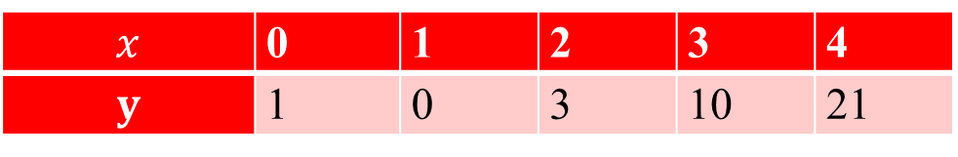

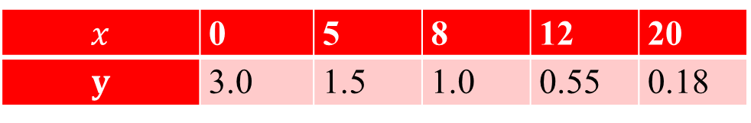
Daily Quiz (CO2)
Q1. Fit a second degree parabola to the following data-
Q2. Find the best values of a & b for $y = ae^{bx}$ by the method of least squares to the following data:
$$x$$ | 0 | 1 | 2 | 3 | 4
$$y$$ | 1 | 0 | 3 | 10 | 21
$$x$$ | 0 | 5 | 8 | 12 | 20
$$y$$ | 3.0 | 1.5 | 1.0 | 0.55 | 0.18

Slide 20

Recap (CO2)
Moments
Relation between $v_{r} and μ_{r}$
Relation between $μ_{r} and {μ′}_{r}$
Skewness & kurtosis
Curve fitting

Slide 21
Topic objective (CO2)
Correlation
Identify the direction and strength of a correlation between two factors.
Compute and interpret the Pearson correlation coefficient and test for significance.
Compute and interpret the coefficient of determination.
Compute and interpret the Spearman correlation coefficient and test for significance.

Slide 22
Correlation (CO2)
Correlation: In a bivariate distribution we are interested to find out i f there is any correlation between the two variables under study.
If the change in one variable affects a change in the other variable, the variables are said to be correlated.
Positive Correlation
If the two variables deviate in the same direction, i.e., if the increase (or decrease) in one results in a corresponding increase (or decrease) in the other, correlation is said to be direct or positive.
For example, the correlation between (i) the heights and weights of a group of persons, and (ii) the income and expenditure; is positive.

Slide 23
Correlation (CO2)
Negative Correlation:
If the two variables deviate in the opposite directions, i.e., if increase (or decrease) in one results in corresponding decrease (or increase) in the other, correlation is said to be diverse or negative.
For example, the correlation between (i) the price and demand of a commodity, and (ii) the volume and pressure of a perfect gas; is negative.
Perfect Correlation:
Correlation is said to be perfect if the deviation in one variable is followed by a corresponding and proportional deviation in the other.

Slide 24
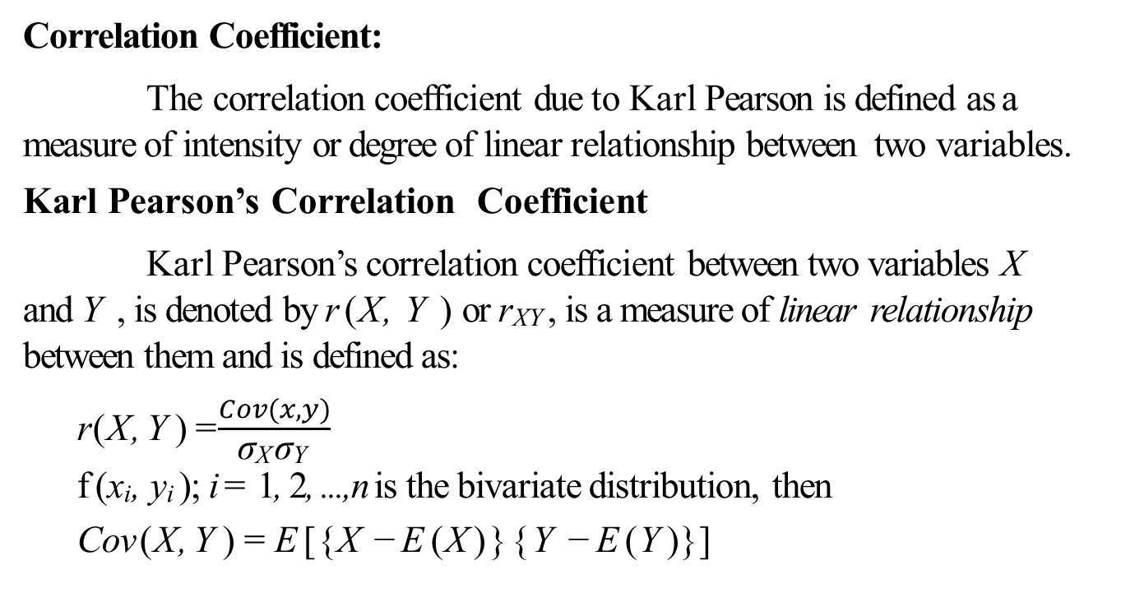
Correlation (CO2)
Correlation Coefficient:
The correlation coefficient due to Karl Pearson is defined as a measure of intensity or degree of linear relationship between two variables.
Karl Pearson’s Correlation Coefficient
Karl Pearson’s correlation coefficient between two variables X and Y , is denoted by r (X, Y ) or r_{XY} , is a measure of linear relationship between them and is defined as:
  r (X, Y ) =$\frac{Cov(x,y)}{\text{σ}\text{X} \text{σ}\text{Y} }$
  f (x_{i}, y_{i} ); i = 1, 2, ..., n is the bivariate distribution, then
  Cov (X, Y ) = E [{X − E (X )}{Y − E (Y )}]

Slide 25
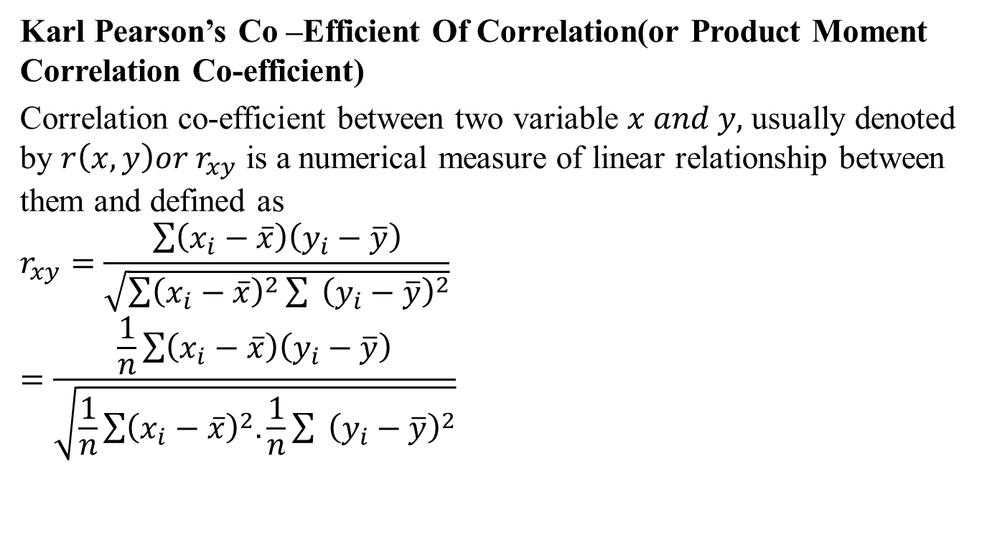
Correlation (CO2)
Karl Pearson’s Co –Efficient Of Correlation(or Product Moment Correlation Co-efficient)
Correlation co-efficient between two variable $x and y,$ usually denoted by $r\left(x,y\right)or r_{xy}$ is a numerical measure of linear relationship between them and defined as
$$r_{xy}=\frac{\sum{\left(x_{i}−\overline{x}\right)\left(y_{i}−\overline{y}\right)}}{\sqrt{\sum{{\left(x_{i}−\overline{x}\right)}^{2}{\sum{ }\left(y_{i}−\overline{y}\right)}^{2}}}}$$
$$=\frac{\frac{1}{n}\sum{\left(x_{i}−\overline{x}\right)\left(y_{i}−\overline{y}\right)}}{\sqrt{\frac{1}{n}\sum{{\left(x_{i}−\overline{x}\right)}^{2}.\frac{1}{n}{\sum{ }\left(y_{i}−\overline{y}\right)}^{2}}}}$$

Slide 26
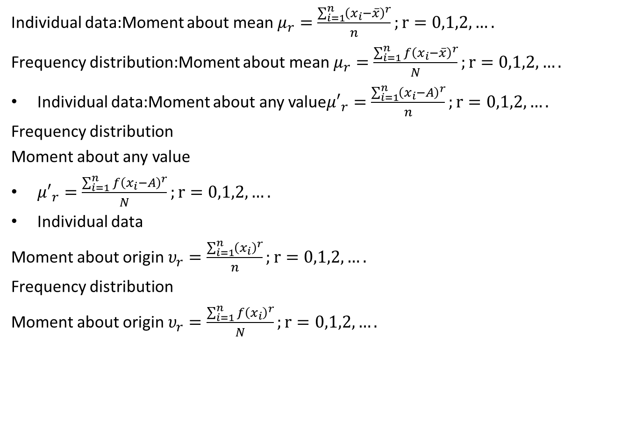
Correlation (CO2)
$$=\frac{\frac{1}{n}\sum{\left(x_{i}−\overline{x}\right)\left(y_{i}−\overline{y}\right)}}{σ_{x}σ_{y}}$$
$$r_{xy}=\frac{\sum{\left(x−\overline{x}\right)\left(y−\overline{y}\right)}}{nσ_{x}σ_{y}}$$
Or $r\left(x,y\right)=\frac{n\sum{xy}−\sum{x}\sum{y}}{\sqrt{n\sum{x^{2}−{\left(\sum{x}\right)}^{2}}}\sqrt{n\sum{y^{2}−{\left(\sum{y}\right)}^{2}}}}$
Here $n$is the no. of pairs of values of $x and y.$
Note: Correlation co efficient is independent of change of origin and scale.
Let us define two new variables $u and v as$
$u=\frac{x−a}{h},v=\frac{y−b}{k}$where $a,b,h,k are constant then r_{xy}=r_{uv}$
Then $r\left(u,v\right)=$ $\frac{n\sum{uv}−\sum{u}\sum{v}}{\sqrt{n\sum{u^{2}−{\left(\sum{u}\right)}^{2}}}\sqrt{n\sum{v^{2}−{\left(\sum{v}\right)}^{2}}}}$

Slide 27
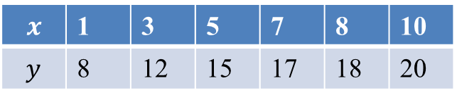


Correlation (CO2)
Q.Find the coefficient of correlation between the values of $x and y:$
Sol. Here $n=6.$ The table is as follows.
$$x$$ | 1 | 3 | 5 | 7 | 8 | 10
$$y$$ | 8 | 12 | 15 | 17 | 18 | 20
$$x$$ | $$y$$ | $$x^{2}$$ | $$y^{2}$$ | $$xy$$
1 | 8 | 1 | 64 | 8
3 | 12 | 9 | 144 | 36
5 | 15 | 25 | 225 | 75
7 | 17 | 49 | 289 | 119
8 | 18 | 64 | 324 | 144
10 | 20 | 100 | 400 | 200
$$\sum{x=34}$$ | $$\sum{y=90}$$ | $$\sum{x^{2}=248}$$ | $$\sum{y^{2}=1446}$$ | $$\sum{xy=582}$$

Slide 28
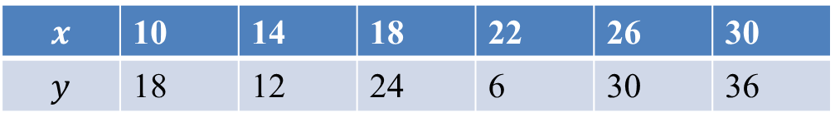
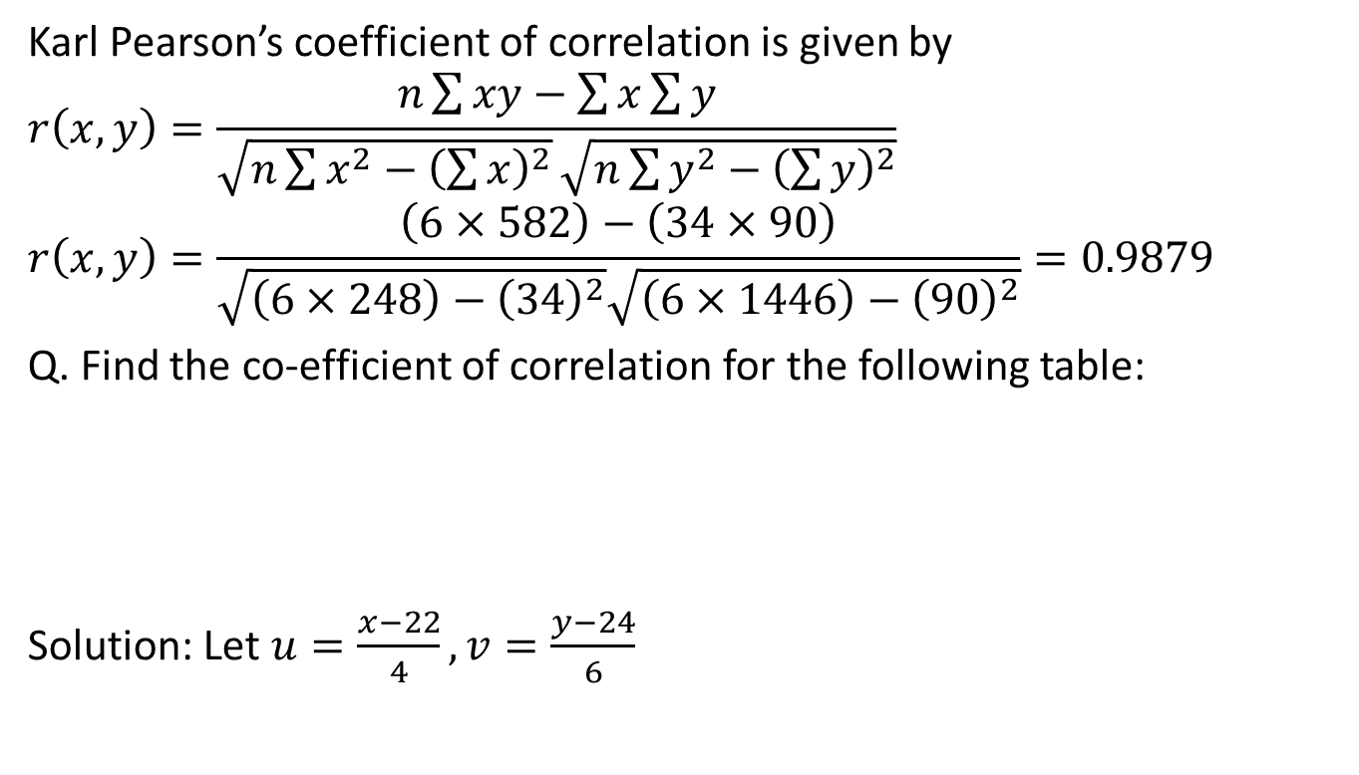
Correlation (CO2)
Karl Pearson’s coefficient of correlation is given by
$$r\left(x,y\right)=\frac{n\sum{xy}−\sum{x}\sum{y}}{\sqrt{n\sum{x^{2}−{\left(\sum{x}\right)}^{2}}}\sqrt{n\sum{y^{2}−{\left(\sum{y}\right)}^{2}}}}$$
$$r\left(x,y\right)=\frac{\left(6×582\right)−\left(34×90\right)}{\sqrt{\left(6×248\right)−{\left(34\right)}^{2}}\sqrt{\left(6×1446\right)−{\left(90\right)}^{2}}}=0.9879$$
Q. Find the co-efficient of correlation for the following table:
Solution: Let $u=\frac{x−22}{4},v=\frac{y−24}{6}$
$$x$$ | 10 | 14 | 18 | 22 | 26 | 30
$$y$$ | 18 | 12 | 24 | 6 | 30 | 36

Slide 29
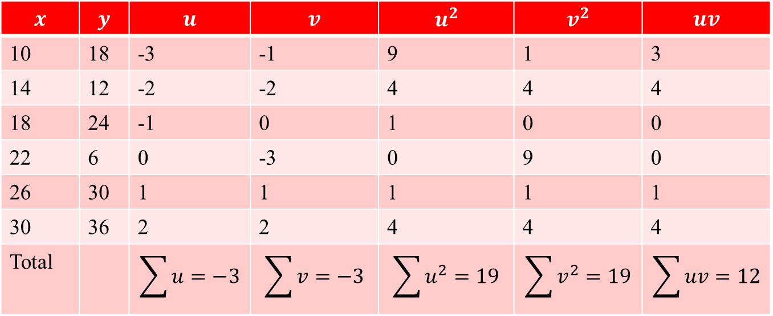
Correlation (CO2)
$$x$$ | $$y$$ | $$u$$ | $$v$$ | $$u^{2}$$ | $$v^{2}$$ | $$uv$$
10 | 18 | -3 | -1 | 9 | 1 | 3
14 | 12 | -2 | -2 | 4 | 4 | 4
18 | 24 | -1 | 0 | 1 | 0 | 0
22 | 6 | 0 | -3 | 0 | 9 | 0
26 | 30 | 1 | 1 | 1 | 1 | 1
30 | 36 | 2 | 2 | 4 | 4 | 4
Total |  | $$\sum{u}=−3$$ | $$\sum{v}=−3$$ | $$\sum{u^{2}=19}$$ | $$\sum{v^{2}=19}$$ | $$\sum{uv}=12$$

Slide 30
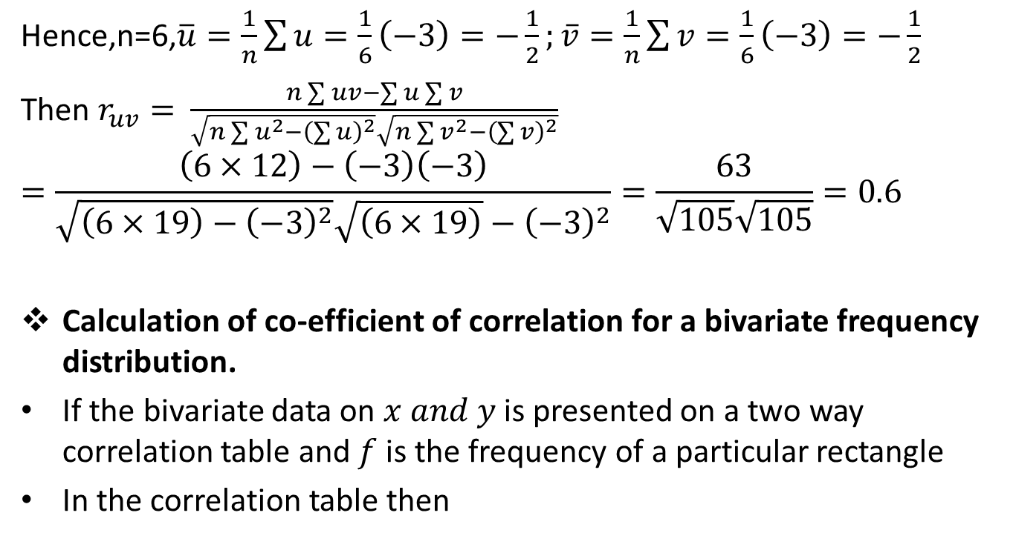
Correlation (CO2)
Hence,n=6,$\overline{u}=\frac{1}{n}\sum{u=\frac{1}{6}\left(−3\right)=−\frac{1}{2};}\overline{v}=\frac{1}{n}\sum{v}=\frac{1}{6}\left(−3\right)=−\frac{1}{2}$
Then $r_{uv}=$ $\frac{n\sum{uv}−\sum{u}\sum{v}}{\sqrt{n\sum{u^{2}−{\left(\sum{u}\right)}^{2}}}\sqrt{n\sum{v^{2}−{\left(\sum{v}\right)}^{2}}}}$
$$=\frac{\left(6×12\right)−\left(−3\right)\left(−3\right)}{\sqrt{\left(6×19\right)−{\left(−3\right)}^{2}}\sqrt{\left(6×19\right)}−{\left(−3\right)}^{2}}=\frac{63}{\sqrt{105}\sqrt{105}}=0.6$$
Calculation of co-efficient of correlation for a bivariate frequency distribution.
If the bivariate data on $x and y$is presented on a two way correlation table and $f$is the frequency of a particular rectangle
In the correlation table then

Slide 31
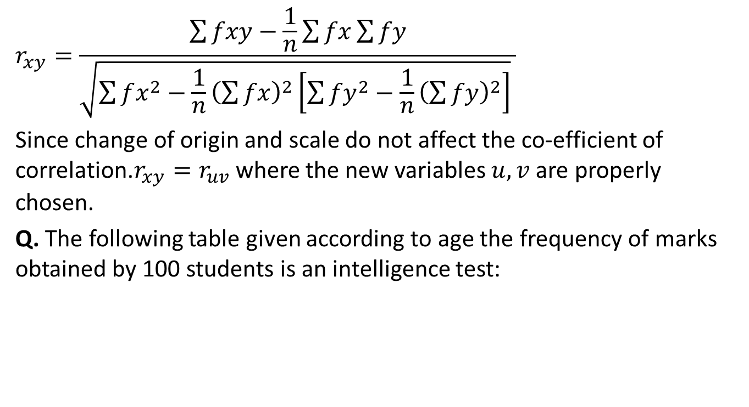
Correlation (CO2)
$$r_{xy}=\frac{\sum{fxy}−\frac{1}{n}\sum{fx}\sum{fy}}{\sqrt{\sum{fx^{2}−\frac{1}{n}{\left(\sum{fx}\right)}^{2}}\left[\sum{{fy}^{2}−\frac{1}{n}{\left(\sum{fy}\right)}^{2}}\right]} }$$
Since change of origin and scale do not affect the co-efficient of correlation.$r_{xy}=r_{uv}$where the new variables $u,v$ are properly chosen.
Q. The following table given according to age the frequency of marks obtained by 100 students is an intelligence test:

Slide 32

Correlation (CO2)
Calculate the coefficient of correlation between age and intelligence.
Solution: Age and intelligence be denoted by $x and y$ respectively.
Marks | 18 | 19 | 20 | 21 | total
10-20 | 4 | 2 | 2 |  | 8
20-30 | 5 | 4 | 6 | 4 | 19
30-40 | 6 | 8 | 10 | 11 | 35
40-50 | 4 | 4 | 6 | 8 | 22
50-60 |  | 2 | 4 | 4 | 10
60-70 |  | 2 | 3 | 1 | 6
Total | 19 | 22 | 31 | 28 | 100

Slide 33
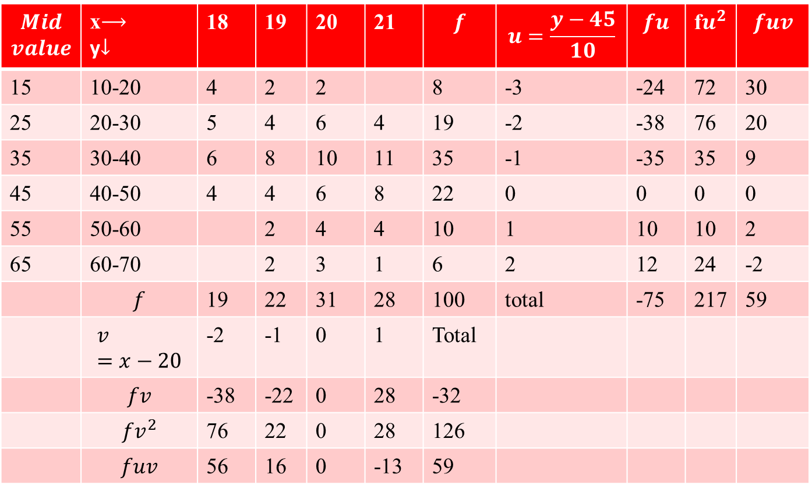
Correlation (CO2)
$$Mid$$ $$value$$ | x$⟶$ y$↓$ | 18 | 19 | 20 | 21 | $$f$$ | $$u=\frac{y−45}{10}$$ | $$fu$$ | f$u^{2}$ | $$fuv$$
15 | 10-20 | 4 | 2 | 2 |  | 8 | -3 | -24 | 72 | 30
25 | 20-30 | 5 | 4 | 6 | 4 | 19 | -2 | -38 | 76 | 20
35 | 30-40 | 6 | 8 | 10 | 11 | 35 | -1 | -35 | 35 | 9
45 | 40-50 | 4 | 4 | 6 | 8 | 22 | 0 | 0 | 0 | 0
55 | 50-60 |  | 2 | 4 | 4 | 10 | 1 | 10 | 10 | 2
65 | 60-70 |  | 2 | 3 | 1 | 6 | 2 | 12 | 24 | -2
 | $$f$$ | 19 | 22 | 31 | 28 | 100 | total | -75 | 217 | 59
 | $$v=x−20$$ | -2 | -1 | 0 | 1 | Total
 | $$fv$$ | -38 | -22 | 0 | 28 | -32
 | $${fv}^{2}$$ | 76 | 22 | 0 | 28 | 126
 | $$fuv$$ | 56 | 16 | 0 | -13 | 59

Slide 34
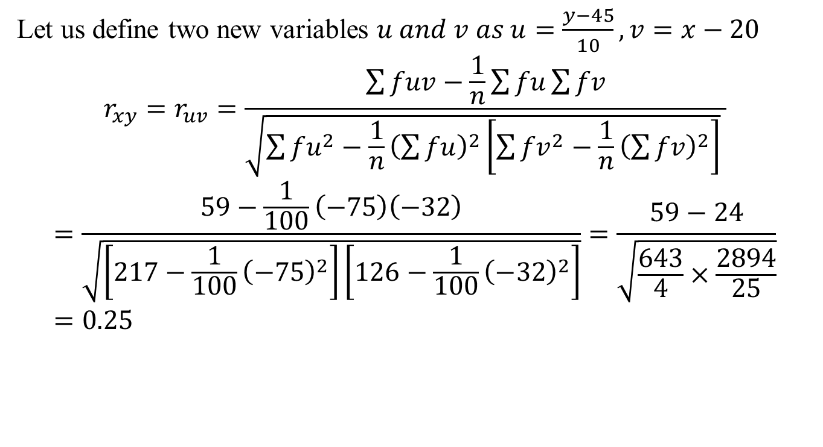
Correlation (CO2)
Let us define two new variables $u and v as u=\frac{y−45}{10},v=x−20$
$$r_{xy}=r_{uv}=\frac{\sum{fuv}−\frac{1}{n}\sum{fu}\sum{fv}}{\sqrt{\sum{fu^{2}−\frac{1}{n}{\left(\sum{fu}\right)}^{2}}\left[\sum{{fv}^{2}−\frac{1}{n}{\left(\sum{fv}\right)}^{2}}\right]} }$$
$$=\frac{59−\frac{1}{100}\left(−75\right)\left(−32\right)}{\sqrt{\left[217−\frac{1}{100}{\left(−75\right)}^{2}\right]\left[126−\frac{1}{100}{\left(−32\right)}^{2}\right]}}=\frac{59−24}{\sqrt{\frac{643}{4}×\frac{2894}{25}}}=0.25$$

Slide 35
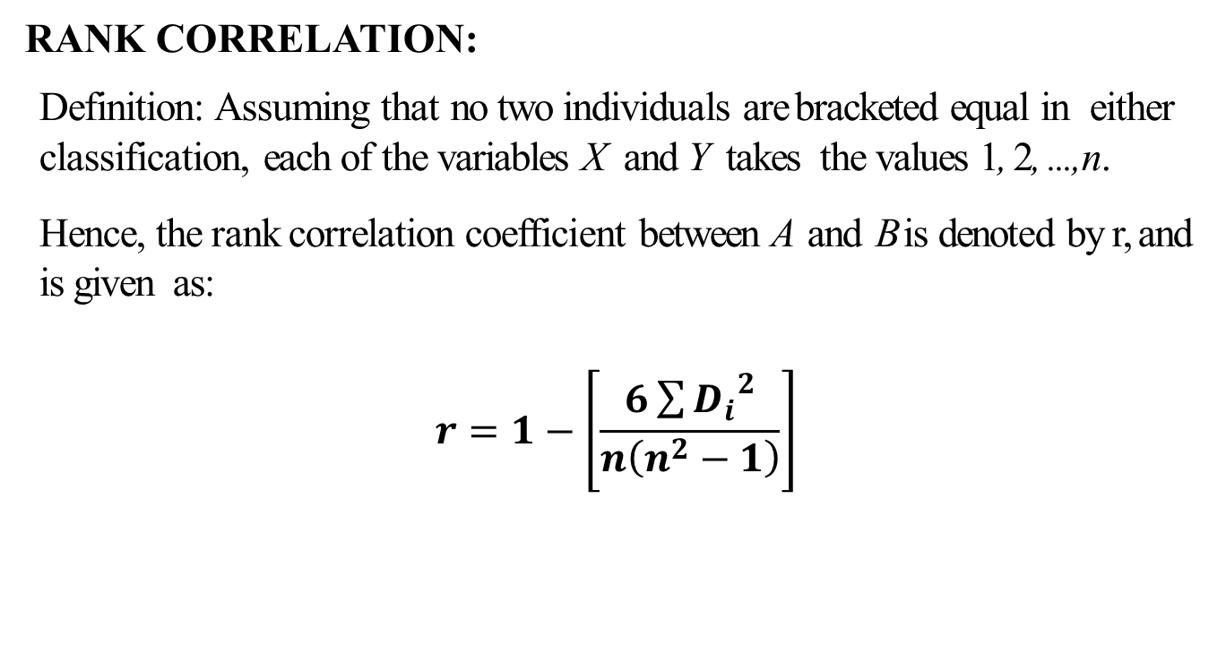
Rank Correlation (CO2)
RANK CORRELATION:
Definition: Assuming that no two individuals are bracketed equal in either classification, each of the variables X and Y takes the values 1, 2, ..., n.
Hence, the rank correlation coefficient between A and Bis denoted by r, and is given as:
$$r=1−\left[\frac{6\sum{{D_{i}}^{2}}}{n\left(n^{2}−1\right)}\right]$$

Slide 36
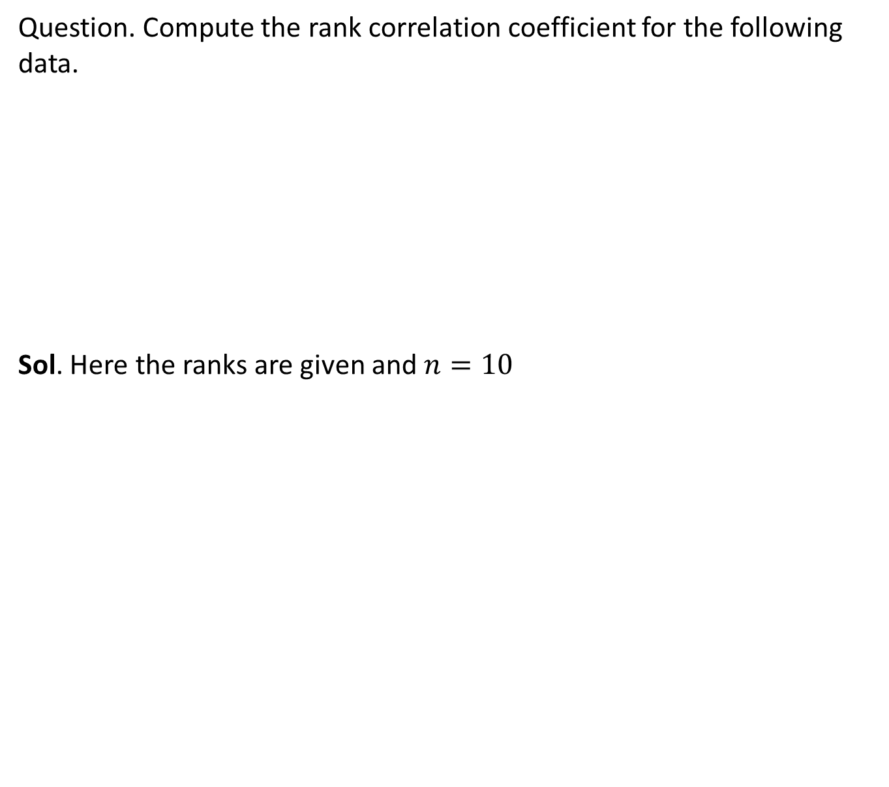
Rank Correlation (CO2)
Question. Compute the rank correlation coefficient for the following data.
Sol. Here the ranks are given and $n=10$
Person | A | B | C | D | E | F | G | H | I | J
Rank in maths | 9 | 10 | 6 | 5 | 7 | 2 | 4 | 8 | 1 | 3
Rank in physics | 1 | 2 | 3 | 4 | 5 | 6 | 7 | 8 | 9 | 10

Slide 37
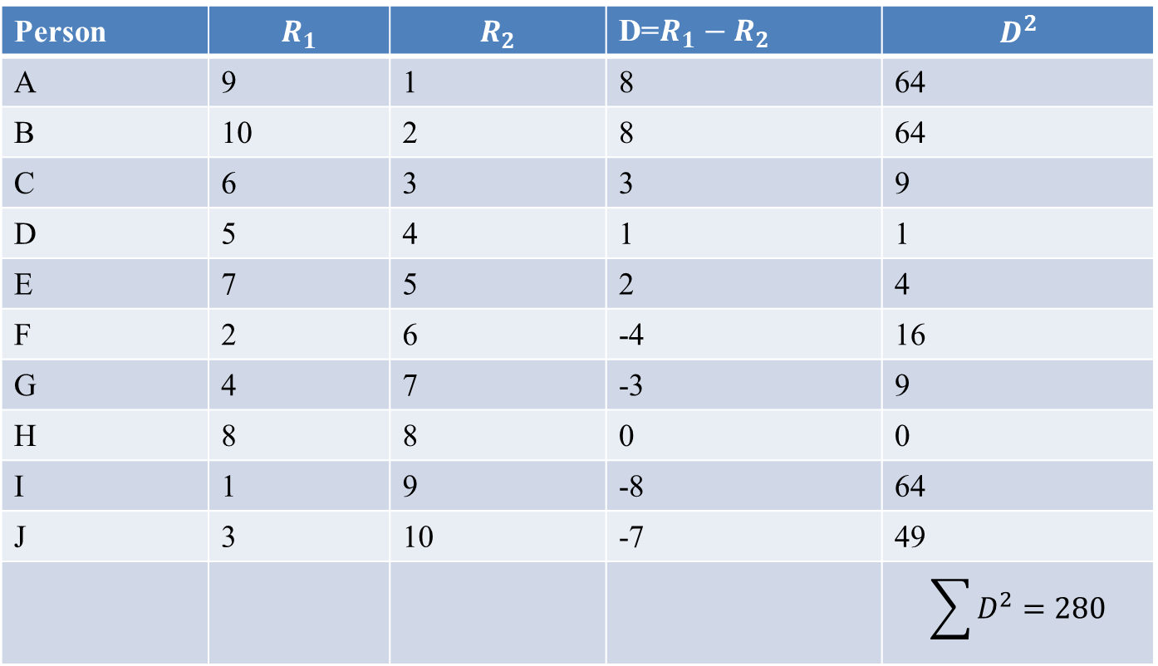
Rank Correlation (CO2)
Person | $$R_{1}$$ | $$R_{2}$$ | D=$R_{1}−R_{2}$ | $$D^{2}$$
A | 9 | 1 | 8 | 64
B | 10 | 2 | 8 | 64
C | 6 | 3 | 3 | 9
D | 5 | 4 | 1 | 1
E | 7 | 5 | 2 | 4
F | 2 | 6 | -4 | 16
G | 4 | 7 | -3 | 9
H | 8 | 8 | 0 | 0
I | 1 | 9 | -8 | 64
J | 3 | 10 | -7 | 49
 |  |  |  | $$\sum{D^{2}=280}$$

Slide 38
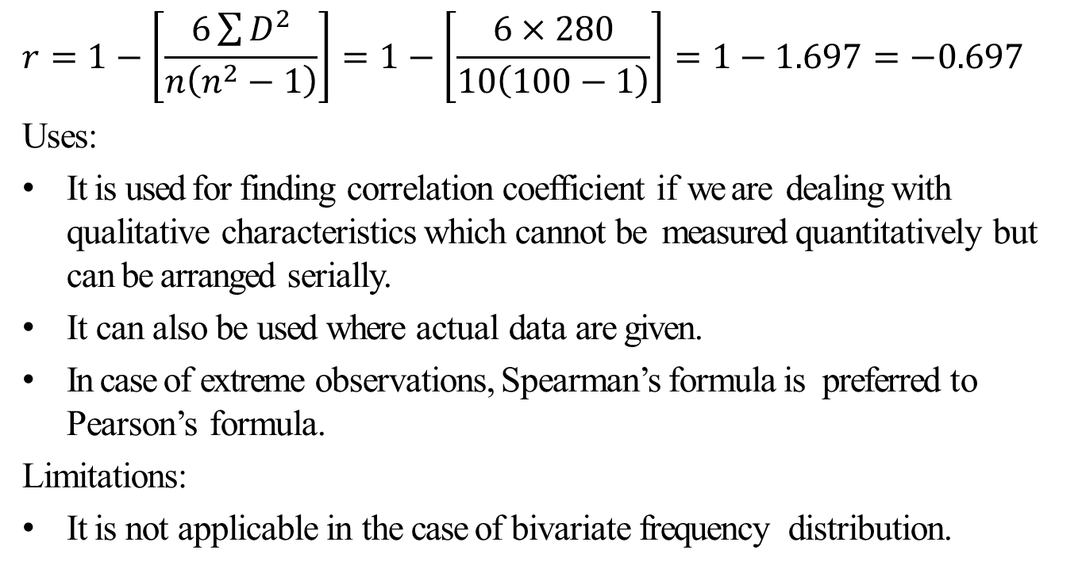
Rank Correlation (CO2)
$$r=1−\left[\frac{6\sum{D^{2}}}{n\left(n^{2}−1\right)}\right]=1−\left[\frac{6×280}{10\left(100−1\right)}\right]=1−1.697=−0.697$$
Uses:
It is used for finding correlation coefficient if we are dealing with qualitative characteristics which cannot be measured quantitatively but can be arranged serially.
It can also be used where actual data are given.
In case of extreme observations, Spearman’s formula is preferred to Pearson’s formula.
Limitations:
It is not applicable in the case of bivariate frequency distribution.

Slide 39
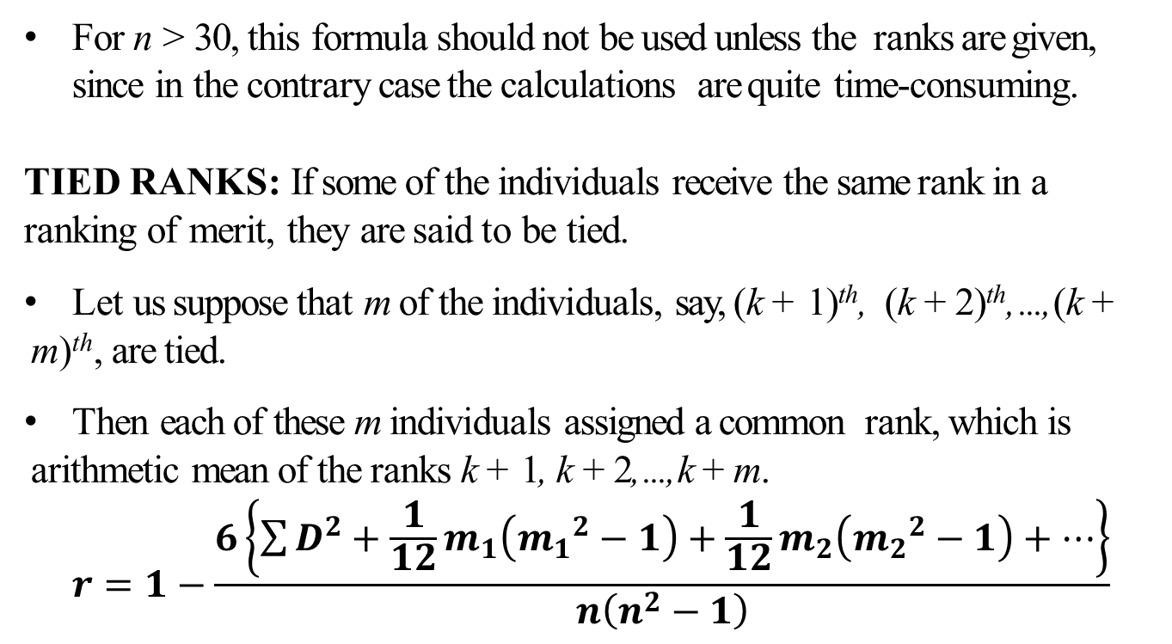
Tied Correlation (CO2)
For n > 30, this formula should not be used unless the ranks are given, since in the contrary case the calculations are quite time-consuming.
TIED RANKS: If some of the individuals receive the same rank in a ranking of merit, they are said to be tied.
Let us suppose that m of the individuals, say, (k + 1)^{th}, (k + 2)^{th}, ..., (k + m)^{th}, are tied.
Then each of these m individuals assigned a common rank, which is arithmetic mean of the ranks k + 1, k + 2, ..., k + m.
$$r=1−\frac{6\left\{\sum{D^{2}+\frac{1}{12}m_{1}\left({m_{1}}^{2}−1\right)+\frac{1}{12}m_{2}\left({m_{2}}^{2}−1\right)+…}\right\}}{n\left(n^{2}−1\right)}$$

Slide 40
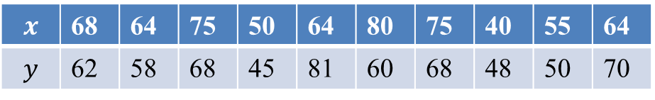
Tied Correlation (CO2)
Question: Obtain the rank correlation co-efficient for the following data:
Solution: Here marks are given so write down the ranks
$$x$$ | 68 | 64 | 75 | 50 | 64 | 80 | 75 | 40 | 55 | 64
$$y$$ | 62 | 58 | 68 | 45 | 81 | 60 | 68 | 48 | 50 | 70

Slide 41
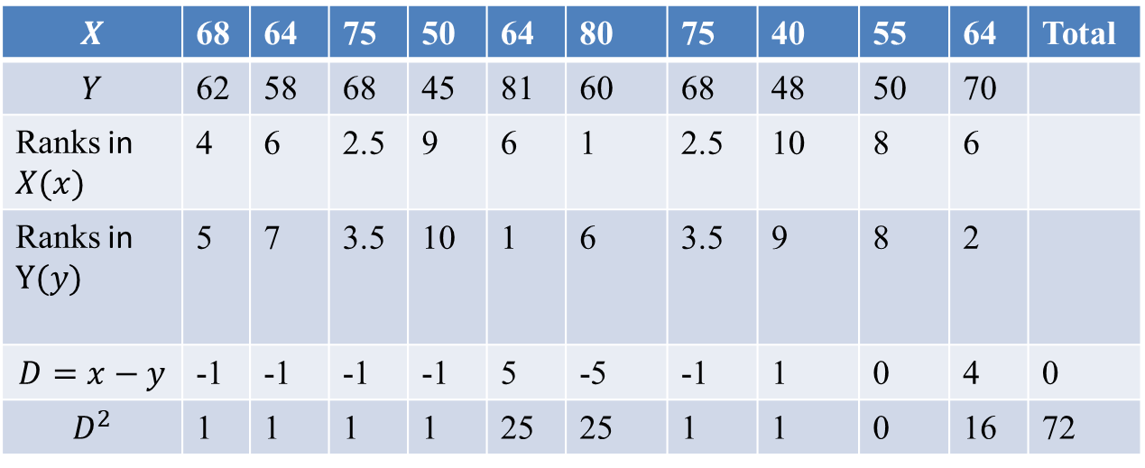
Tied Correlation (CO2)
75
75 2 times
64 3 times
68 2 times
$$X$$ | 68 | 64 | 75 | 50 | 64 | 80 | 75 | 40 | 55 | 64 | Total
$$Y$$ | 62 | 58 | 68 | 45 | 81 | 60 | 68 | 48 | 50 | 70
Ranks in $X(x)$ | 4 | 6 | 2.5 | 9 | 6 | 1 | 2.5 | 10 | 8 | 6
Ranks in $Y(y)$ | 5 | 7 | 3.5 | 10 | 1 | 6 | 3.5 | 9 | 8 | 2
$$D=x−y$$ | -1 | -1 | -1 | -1 | 5 | -5 | -1 | 1 | 0 | 4 | 0
$$D^{2}$$ | 1 | 1 | 1 | 1 | 25 | 25 | 1 | 1 | 0 | 16 | 72

Slide 42
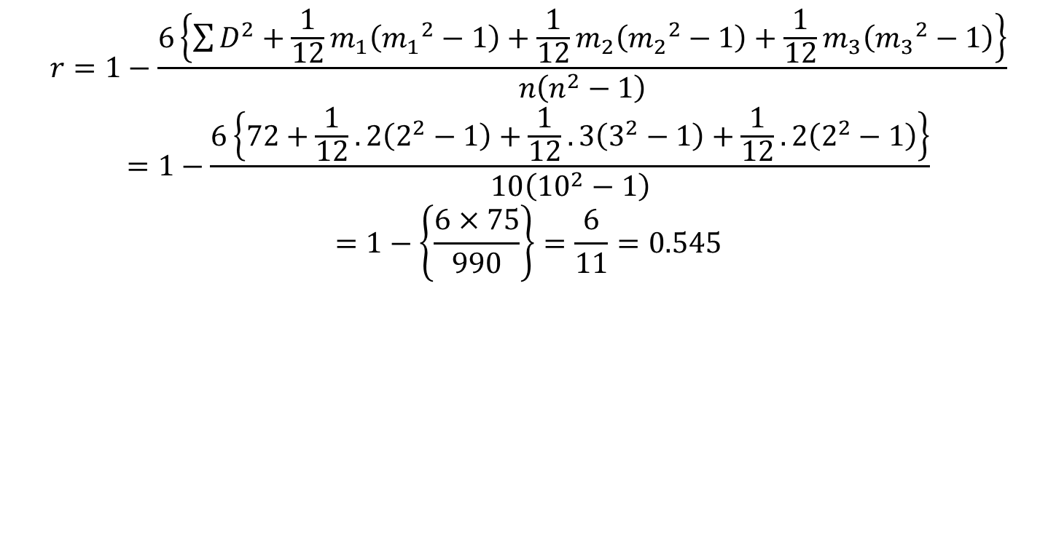
Tied Correlation (CO2)
$$r=1−\frac{6\left\{\sum{D^{2}+\frac{1}{12}m_{1}\left({m_{1}}^{2}−1\right)+\frac{1}{12}m_{2}\left({m_{2}}^{2}−1\right)+\frac{1}{12}m_{3}\left({m_{3}}^{2}−1\right)}\right\}}{n\left(n^{2}−1\right)}$$
$$=1−\frac{6\left\{72+\frac{1}{12}.2\left(2^{2}−1\right)+\frac{1}{12}.3\left(3^{2}−1\right)+\frac{1}{12}.2\left(2^{2}−1\right)\right\}}{10\left({10}^{2}−1\right)}$$
$$=1−\left\{\frac{6×75}{990}\right\}=\frac{6}{11}=0.545$$

Slide 43
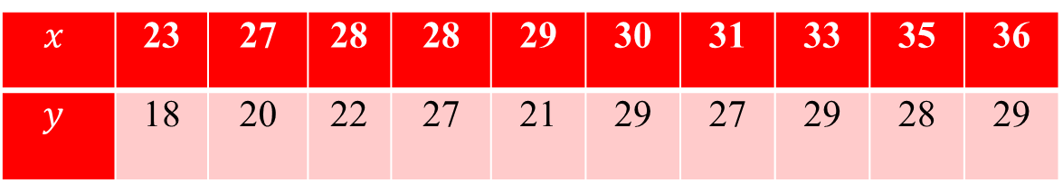
Daily Quiz (CO2)
Q1. Find the rank correlation coefficient for the following data:
Q2. Given the following pairs of values:
Do you think that there is any correlation between profits and capital employed? Is it positive or negative? Is it high or low?
$$x$$ | 23 | 27 | 28 | 28 | 29 | 30 | 31 | 33 | 35 | 36
$$y$$ | 18 | 20 | 22 | 27 | 21 | 29 | 27 | 29 | 28 | 29
Capital Employed (Rs. In Crore) | 1 | 2 | 3 | 4 | 5 | 7 | 8 | 9 | 11 | 12
Profit (Rs. In Lakhs) | 3 | 5 | 4 | 7 | 9 | 8 | 10 | 11 | 12 | 14

Slide 44
Recap (CO2)
Correlation
Karl Pearson coefficient of correlation
Rank Correlation
Tied Rank

Slide 45
Topic objectives (CO2)
Regression
Explanation of the variation in the dependent variable, based on the variation in independent variables and Predict the values of the dependent variable.

Slide 46
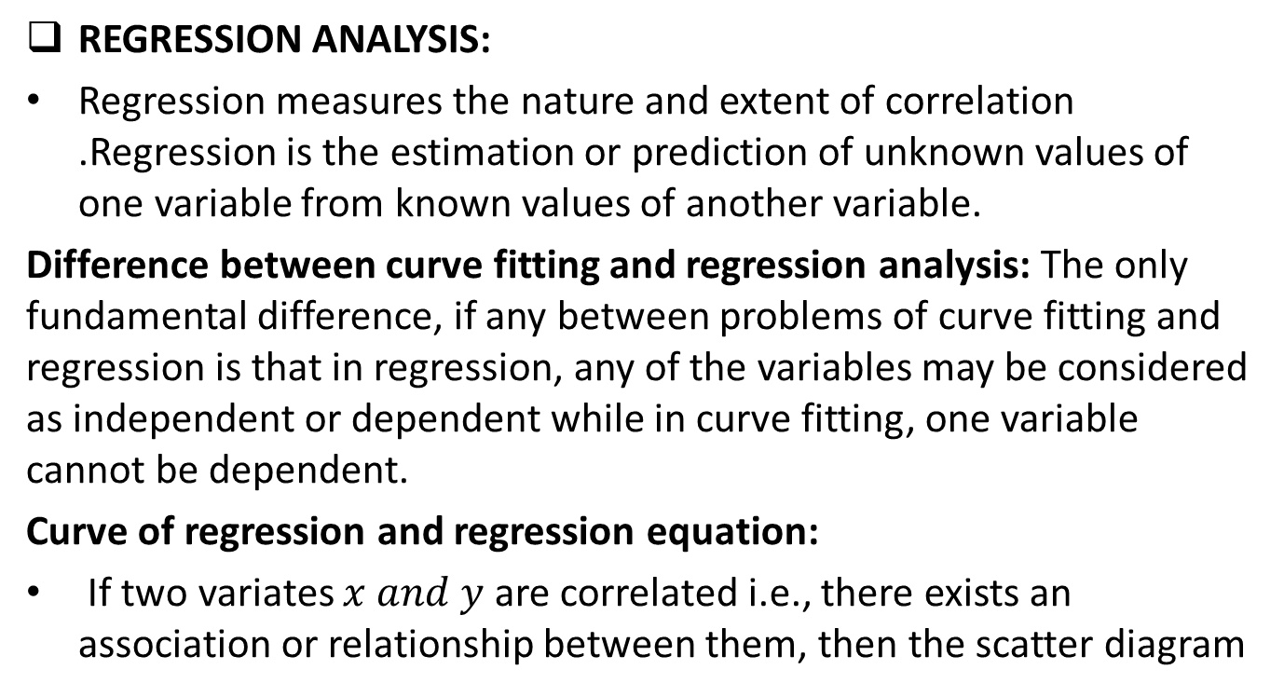
Regression Analysis (CO2)
REGRESSION ANALYSIS:
Regression measures the nature and extent of correlation .Regression is the estimation or prediction of unknown values of one variable from known values of another variable.
Difference between curve fitting and regression analysis: The only fundamental difference, if any between problems of curve fitting and regression is that in regression, any of the variables may be considered as independent or dependent while in curve fitting, one variable cannot be dependent.
Curve of regression and regression equation:
If two variates $x and y$ are correlated i.e., there exists an association or relationship between them, then the scatter diagram

Slide 47
Regression Analysis (CO2)
will be more or less concentrated round a curve. This curve is called the curve of regression and the relationship is said to be expressed by means of curvilinear regression.
The mathematical equation of the regression curve is called regression equation.
Some following types of regression will discuss here:
Linear Regression
Non- linear Regression
Multiple linear Regression

Slide 48
Linear Regression (CO2)
LINEAR REGRESSION:
When the point of the scatter diagram concentrated round a straight line, the regression is called linear and this straight line is known as the line of regression.
Regression will be called non-linear if there exists a relationship other than a straight line between the variables under consideration.

Slide 49
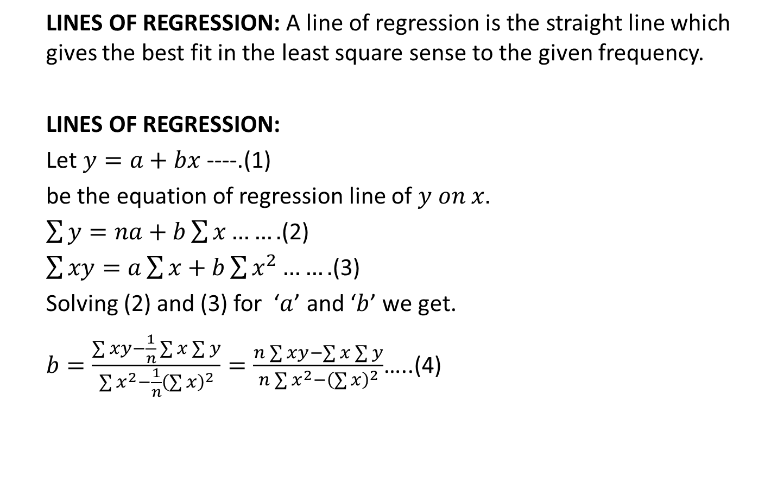
Linear Regression (CO2)
LINES OF REGRESSION: A line of regression is the straight line which gives the best fit in the least square sense to the given frequency.
LINES OF REGRESSION:
Let $y=a+bx$ ----.(1)
be the equation of regression line of $y on x.$
$\sum{y=na+b\sum{x…….}}$(2)
$\sum{xy=a\sum{x}+b\sum{x^{2}…….}}$(3)
Solving (2) and (3) for ‘$a$’ and ‘$b$’ we get.
$b=\frac{\sum{xy}−\frac{1}{n}\sum{x}\sum{y}}{\sum{x^{2}−\frac{1}{n}{\left(\sum{x}\right)}^{2}}}=\frac{n\sum{xy}−\sum{x}\sum{y}}{n\sum{x^{2}−{\left(\sum{x}\right)}^{2}}}$…..(4)

Slide 50
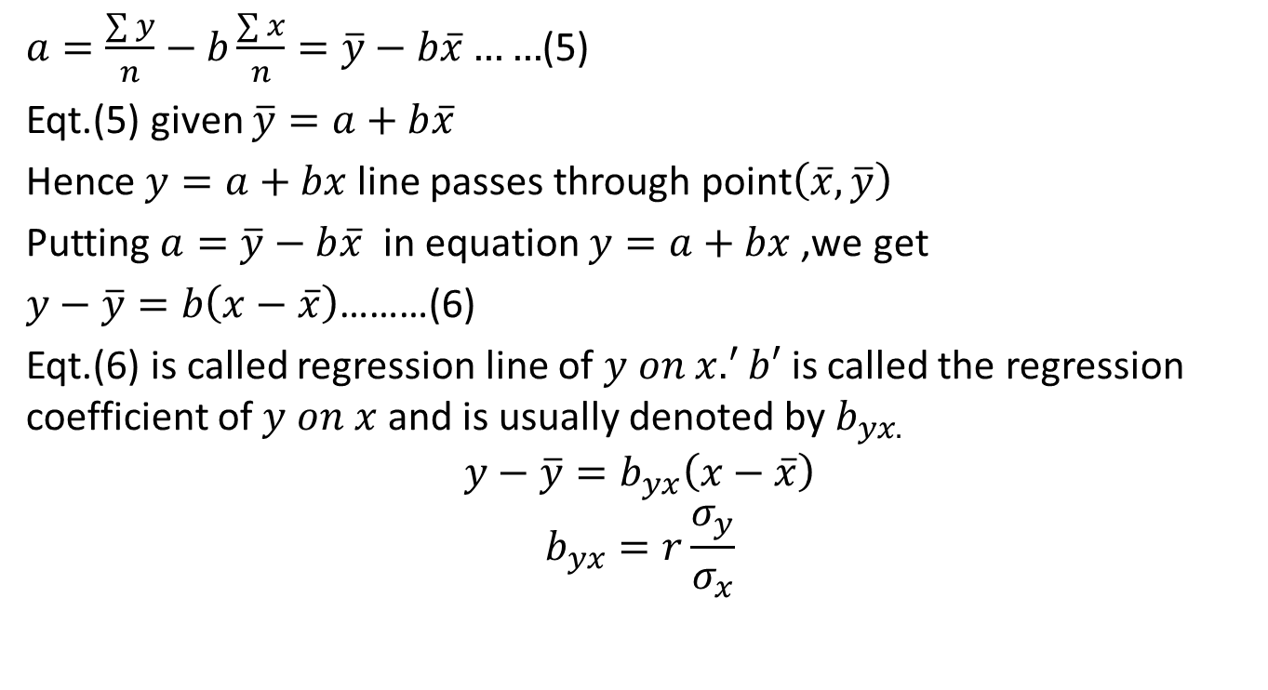
Linear Regression (CO2)
$a=\frac{\sum{y}}{n}−b\frac{\sum{x}}{n}=\overline{y}−b\overline{x}……$(5)
Eqt.(5) given $\overline{y}=a+b\overline{x}$
Hence $y=a+bx$line passes through point$\left(\overline{x},\overline{y}\right)$
Putting $a=\overline{y}−b\overline{x}$ in equation $y=a+bx$,we get
$y−\overline{y}=b\left(x−\overline{x}\right)$………(6)
Eqt.(6) is called regression line of $y on x.^{′}b′$ is called the regression coefficient of $y on x$ and is usually denoted by $b_{yx.}$
$$y−\overline{y}=b_{yx}\left(x−\overline{x}\right)$$
$$b_{yx}=r\frac{σ_{y}}{σ_{x}}$$

Slide 51
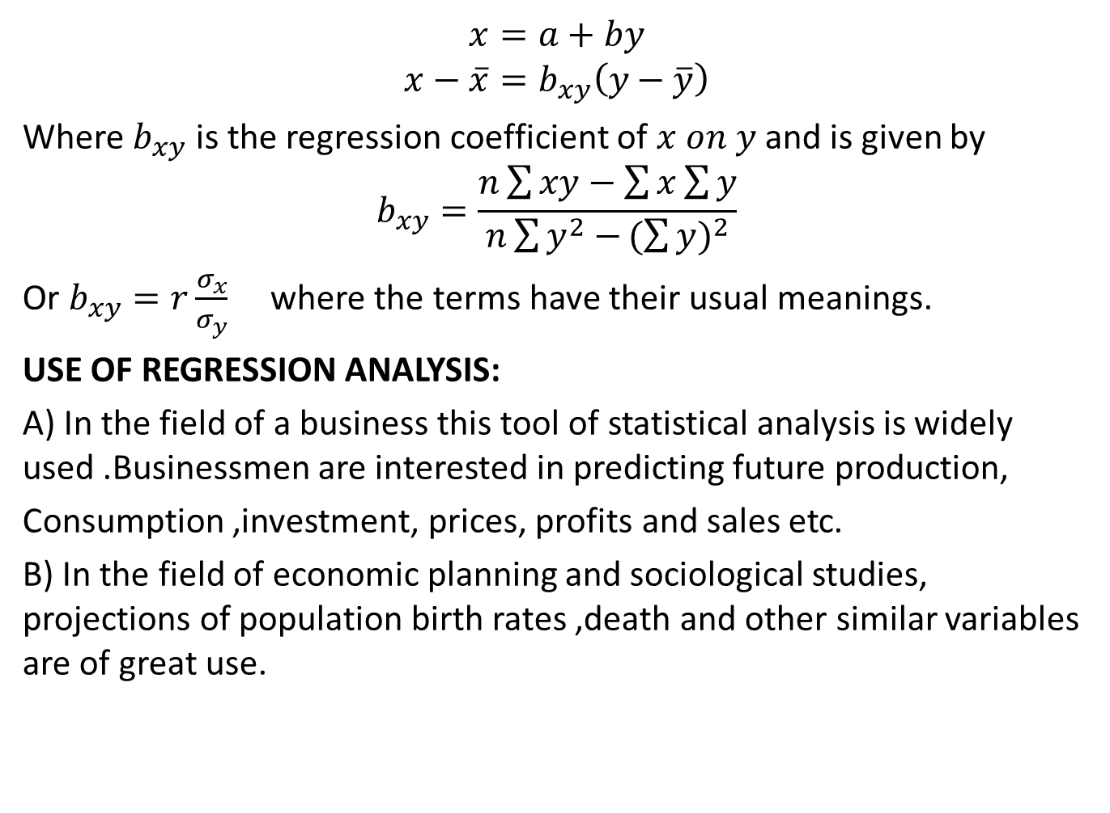
Linear Regression (CO2)
$$x=a+by$$
$$x−\overline{x}=b_{xy}\left(y−\overline{y}\right)$$
Where $b_{xy}$ is the regression coefficient of $x on y$and is given by
$$b_{xy}=\frac{n\sum{xy}−\sum{x}\sum{y}}{n\sum{y^{2}−}{(\sum{y})}^{2}}$$
Or $b_{xy}=r\frac{σ_{x}}{σ_{y}}$ where the terms have their usual meanings.
USE OF REGRESSION ANALYSIS:
A) In the field of a business this tool of statistical analysis is widely used .Businessmen are interested in predicting future production,
Consumption ,investment, prices, profits and sales etc.
B) In the field of economic planning and sociological studies, projections of population birth rates ,death and other similar variables are of great use.

Slide 52
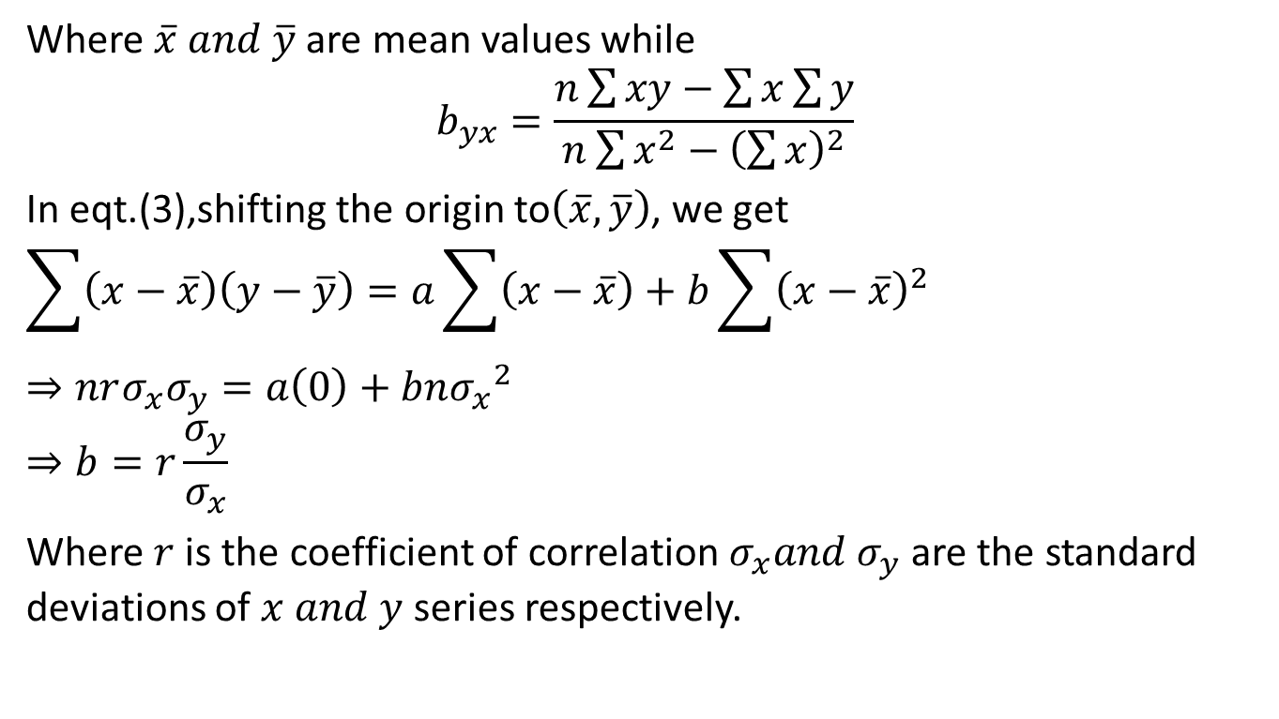
Linear Regression
Where $\overline{x} and \overline{y}$are mean values while
$$b_{yx}=\frac{n\sum{xy}−\sum{x}\sum{y}}{n\sum{x^{2}−{\left(\sum{x}\right)}^{2}}}$$
In eqt.(3),shifting the origin to$\left(\overline{x},\overline{y}\right)$, we get
$$\sum{\left(x−\overline{x}\right)\left(y−\overline{y}\right)=a\sum{\left(x−\overline{x}\right)+b\sum{{\left(x−\overline{x}\right)}^{2}}}}$$
$$⇒nrσ_{x}σ_{y}=a\left(0\right)+bn{σ_{x}}^{2}$$
$$⇒b=r\frac{σ_{y}}{σ_{x}}$$
Where $r$is the coefficient of correlation $σ_{x}{and σ}_{y}$ are the standard deviations of $x and y$ series respectively.

Slide 53
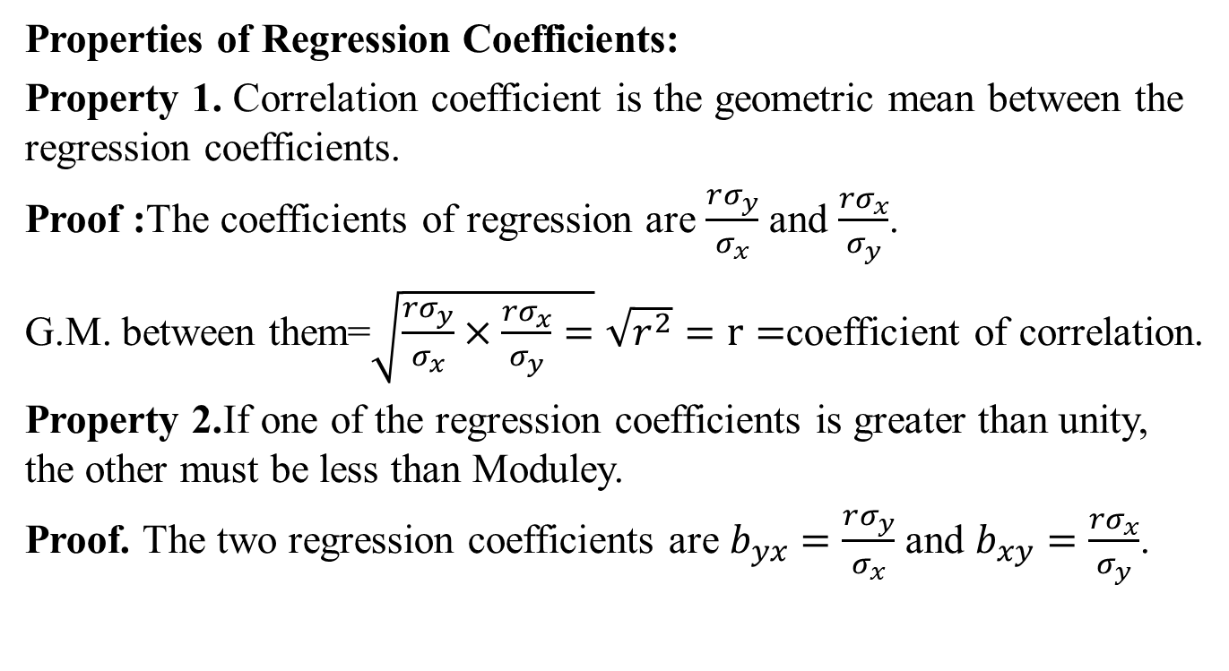
Regression Analysis Properties (CO2)
Properties of Regression Coefficients:
Property 1. Correlation coefficient is the geometric mean between the regression coefficients.
Proof :The coefficients of regression are $\frac{rσ_{y}}{σ_{x}}$ and $\frac{{rσ}_{x}}{σ_{y}}$.
G.M. between them=$\sqrt{\frac{rσ_{y}}{σ_{x}}×\frac{{rσ}_{x}}{σ_{y}}=}\sqrt{r^{2}}=r=$coefficient of correlation.
Property 2.If one of the regression coefficients is greater than unity, the other must be less than Moduley.
Proof. The two regression coefficients are $b_{yx}=\frac{rσ_{y}}{σ_{x}}$ and $b_{xy}=\frac{rσ_{x}}{σ_{y}}$.

Slide 54
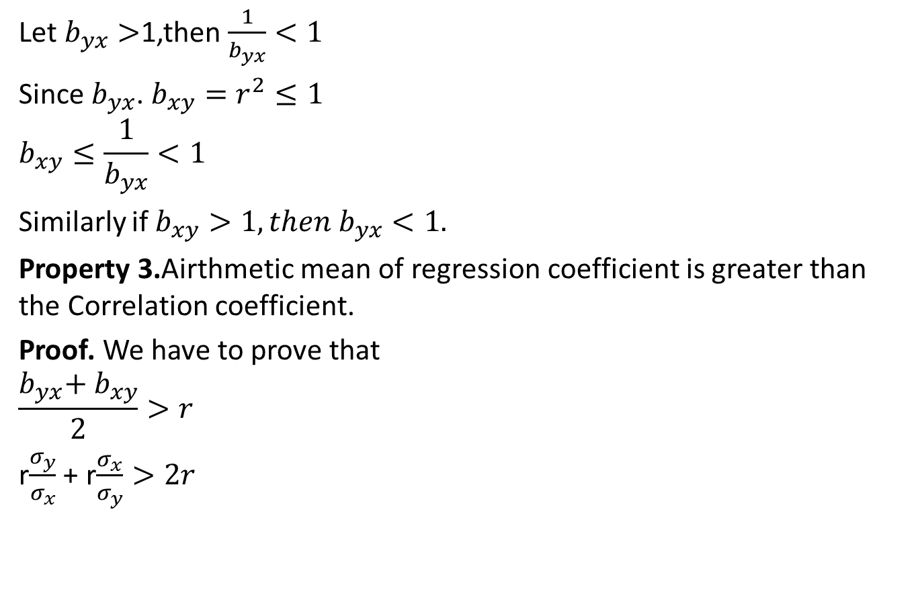
Regression Analysis Properties (CO2)
Let $b_{yx}>$1,then $\frac{1}{b_{yx}}<1$
Since $b_{yx}$. $b_{xy}=r^{2}≤1$
$$b_{xy}≤\frac{1}{b_{yx}}<1$$
Similarly if $b_{xy}>1, then b_{yx}<1.$
Property 3.Airthmetic mean of regression coefficient is greater than the Correlation coefficient.
Proof. We have to prove that
$$\frac{b_{yx}\text{+} b_{xy}}{2}>r$$
r$\frac{σ_{y}}{σ_{x}}$ + r$\frac{σ_{x}}{σ_{y}}>2r$

Slide 55
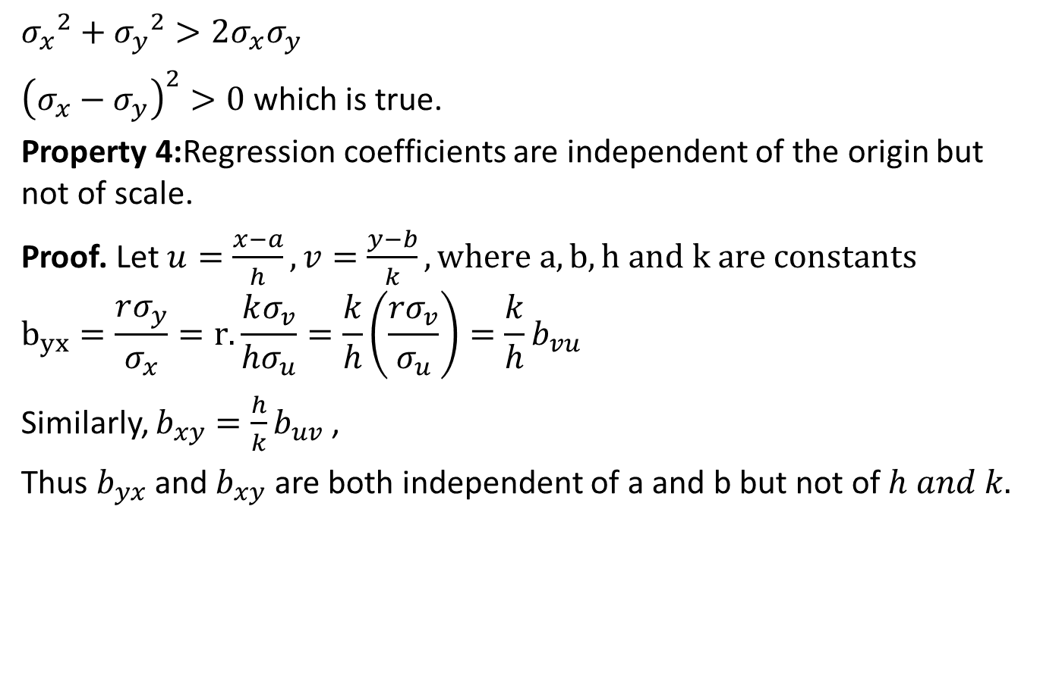
Regression Analysis Properties (CO2)
$${σ_{x}}^{2}+{σ_{y}}^{2}>2σ_{x}σ_{y}$$
${\left(σ_{x}−σ_{y}\right)}^{2}>0$ which is true.
Property 4:Regression coefficients are independent of the origin but not of scale.
Proof. Let $u=\frac{x−a}{h},v=\frac{y−b}{k},where a,b,h and k are constants$
$$b_{yx}=\frac{rσ_{y}}{σ_{x}}=r.\frac{kσ_{v}}{hσ_{u}}=\frac{k}{h}\left(\frac{{rσ}_{v}}{σ_{u}}\right)=\frac{k}{h}b_{vu}$$
Similarly, $b_{xy}=\frac{h}{k}b_{uv}$ ,
Thus $b_{yx}$ and $b_{xy}$ are both independent of a and b but not of $h and k.$

Slide 56
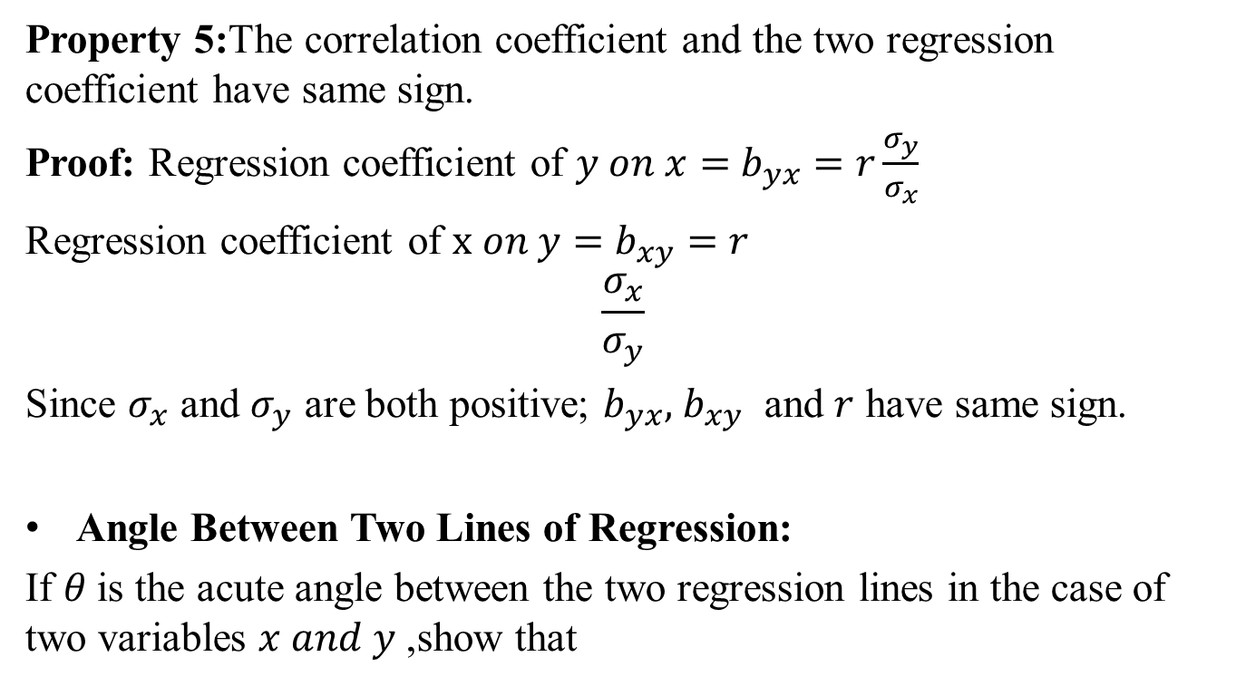
Regression Analysis Properties (CO2)
Property 5:The correlation coefficient and the two regression coefficient have same sign.
Proof: Regression coefficient of $y on x=$ $b_{yx}=r\frac{σ_{y}}{σ_{x}}$
Regression coefficient of $x on y=$ $b_{xy}=r$
$$\frac{σ_{x}}{σ_{y}}$$
Since $σ_{x}$ and $σ_{y}$ are both positive; $b_{yx},$ $b_{xy}$ and $r$ have same sign.
Angle Between Two Lines of Regression:
If $θ$is the acute angle between the two regression lines in the case of two variables $x and y$ ,show that

Slide 57

Regression Analysis Properties (CO2)
$tanθ=\frac{1−r^{2}}{r}.\frac{σ_{x}σ_{y}}{{σ_{x}}^{2}+{σ_{y}}^{2}},$ where $r,$ $σ_{x,}σ_{y}$ have their usual meanings.
Explain the significance of the formula where $r=0 and r=±1$
Proof: Equations to the lines of regression of $y on x and x on y are$
$y−\overline{y}=$ $\frac{rσ_{y}}{σ_{x}}$ $\left(x−\overline{x}\right)$ and ($x−\overline{x}$)= $\frac{{rσ}_{x}}{σ_{y}}(y−\overline{y)}$
The slopes are $m_{1}=$ $\frac{rσ_{y}}{σ_{x}}$ and $m_{2}=\frac{σ_{y}}{rσ_{x}}$
tan$θ=±\frac{m_{2}−m_{1}}{1+m_{2}m_{1}}=±\frac{\frac{σ_{y}}{rσ_{x}}−\frac{rσ_{y}}{σ_{x}}}{1+\frac{{σ_{y}}^{2}}{{σ_{x}}^{2}}}$

Slide 58
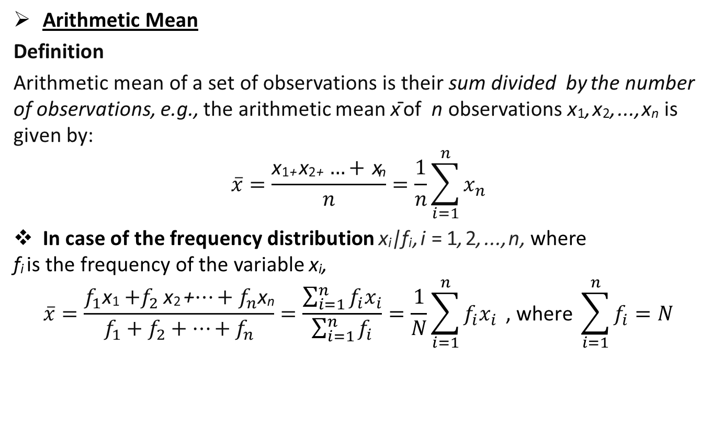
Regression Analysis Properties (CO2)
$$=±\frac{1−r^{2}}{r}.\frac{σ_{y}}{σ_{x}}.\frac{{σ_{x}}^{2}}{{σ_{x}}^{2}+{σ_{y}}^{2}}=±\frac{1−r^{2}}{r}.\frac{σ_{x}σ_{y}}{{σ_{x}}^{2}+{σ_{y}}^{2}}$$
Since $r^{2}≤1$ and $σ_{x}{,σ}_{y}$are positive.
tan$θ=\frac{1−r^{2}}{r}.\frac{σ_{x}σ_{y}}{{σ_{x}}^{2}+{σ_{y}}^{2}}$ Where $r=0,θ=\frac{π}{2}$ the two lines of regression are Perpendicular to each other. Hence the estimated value of $y$ is the same for all values of $x$and vice versa.
When $r=±1,tanθ=0$ so that $θ=0 or π$
Hence the lines of regression coincide and there is perfect correlation between the two variates $x and y.$

Slide 59
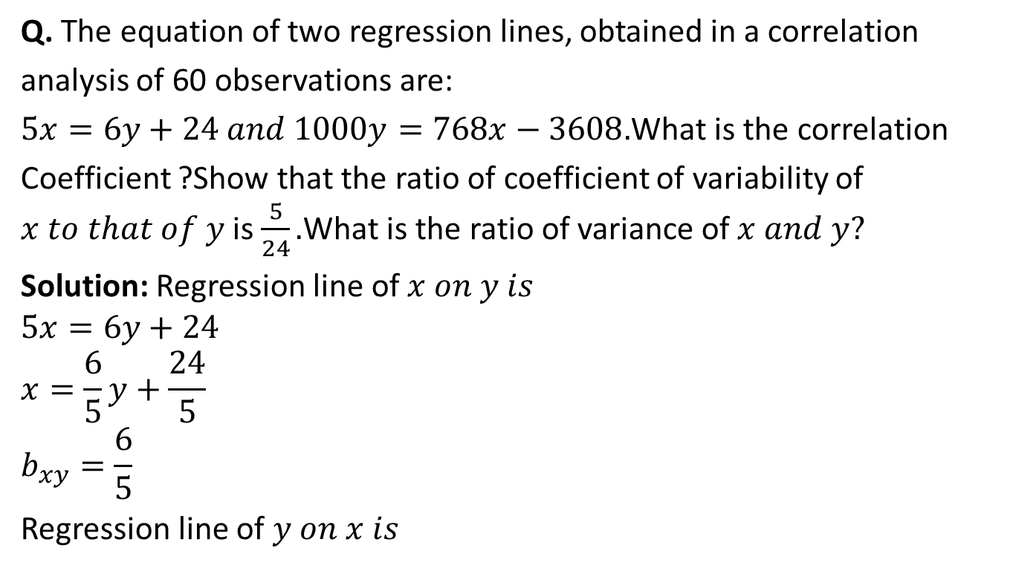
Linear Regression (CO2)
Q. The equation of two regression lines, obtained in a correlation
analysis of 60 observations are:
$5x=6y+24 and 1000y=768x−3608.$What is the correlation
Coefficient ?Show that the ratio of coefficient of variability of $x to that of y$ is $\frac{5}{24}.$What is the ratio of variance of $x and y?$
Solution: Regression line of $x on y is$
$$5x=6y+24$$
$$x=\frac{6}{5}y+\frac{24}{5}$$
$$b_{xy}=\frac{6}{5}$$
Regression line of $y on x is$

Slide 60

Linear Regression (CO2)
$$1000y=768x−3608$$
$$y=0.768x−3.608$$
$$b_{yx}=0.768$$
$r\frac{σ_{x}}{σ_{y}}$=$\frac{6}{5}$……..(3)
$r\frac{σ_{y}}{σ_{x}}$=0.768….(4)
Multiply equations(3) and (4) we get
$$r^{2}=0.9216⇒r=0.96$$
Dividing (3) by (4) we get
$$\frac{{σ_{x}}^{2}}{{σ_{y}}^{2}}=\frac{6}{5}×\frac{1}{0.768}=1.5625$$

Slide 61

Linear Regression (CO2)
Taking square root, we get
$\frac{σ_{x}}{σ_{y}}$=$1.25=\frac{5}{4}$
Since the regression lines pass through the point($\overline{x},\overline{y})$ we have
$$5\overline{x}=6\overline{y}+24$$
1000$\overline{y}=768\overline{x}−3608$
Solving the above equation $\overline{x}and\overline{y}$ ,we get $\overline{x}$=6, $\overline{y}$ =1
Coefficient of variability of $x=\frac{σ_{x}}{\overline{x}}$
Coefficient of variability of $y=\frac{σ_{y}}{\overline{y}}$
Required ratio=$\frac{σ_{x}}{\overline{x}}×$ $\frac{\overline{y}}{σ_{y}}=\frac{\overline{y}}{\overline{x}}\left(\frac{σ_{x}}{σ_{y}}\right)=\frac{1}{6}×\frac{5}{4}=\frac{5}{24}$

Slide 62

Non-Linear Regression (CO2)
Non-linear Regression:
Let $y=a.1+bx+cx^{2}$
Be a second degree parabolic curve of regression of $y$ on $x.$
$$⇒\sum{y}=na+b\sum{x+c\sum{x^{2}}}$$
$$⇒\sum{xy}=a\sum{x+b\sum{x^{2}}+c}\sum{x^{3}}$$
$$⇒\sum{x^{2}y}=a\sum{x^{2}+b\sum{x^{3}}+c}\sum{x^{4}}$$

Slide 63

Multiple Linear Regression (CO2)
Multiple Linear Regression:
Where the dependent variable is a function of two or more linear or non linear independent variables. consider such a linear function as $y=a+bx+cz$
$$\sum{y}=ma+b\sum{x}+c\sum{z}$$
$$\sum{xy}=a\sum{x}+b\sum{x^{2}}+c\sum{xz}$$
$$\sum{yz}=a\sum{z}+b\sum{xz}+c\sum{z^{2}}$$
Solving the above equations we get values of $a,b and c$then we get linear function $y=a+bx+cz$ is called the regression plan.

Slide 64


Multiple Linear Regression(CO2)
Q. Obtain a regression plane by using multiple linear regression
To fit the data given below.
Sol. Let $y=a+bx+cz be the required regression plane where$
$a,b,c are the constants to$ be determined by following equations.
$$\sum{y}=ma+b\sum{x}+c\sum{z}$$
$$\sum{xy}=a\sum{x}+b\sum{x^{2}}+c\sum{xz}$$
$$x$$ | 1 | 2 | 3 | 4
$$y$$ | 12 | 18 | 24 | 30
$$z$$ | 0 | 1 | 2 | 3

Slide 65

Multiple Linear Regression(CO2)
$$\sum{yz}=a\sum{z}+b\sum{xz}+c\sum{z^{2}}$$
Here $m=4$ Substitution yields,
84=$4a+10b+6c$
$$240=10a+30b+20c$$
156=6a+20b+14c
$$a=10,b=2,c=4$$
Hence the required regression plane is
$y=10+2x+4z$

Slide 66

Multiple Linear Regression (CO2)
$$x$$ | $$z$$ | $$y$$ | $$x^{2}$$ | $$z^{2}$$ | $$xy$$ | $$zx$$ | $$yz$$
1 | 0 | 12 | 1 | 0 | 12 | 0 | 0
2 | 1 | 18 | 4 | 1 | 36 | 2 | 18
3 | 2 | 24 | 9 | 4 | 72 | 6 | 48
4 | 3 | 30 | 16 | 9 | 120 | 12 | 90
$$\sum{x=}=10$$ | $$\sum{z=}=6$$ | $$\sum{y=}=84$$ | $$\sum{x^{2} }=30$$ | $$\sum{z^{2} }=14$$ | $$\sum{xy }=240$$ | $$\sum{zx }=20$$ | $$\sum{yz}=156$$

Slide 67

Daily Quiz (CO2)
Q1 Two lines of regression are given by $7x−16y+9=0$and $−4x+5y−3=0$ and $var(x)$=16.Calculate
the mean of $x$ and $y$
variance of $y$
The correlation coefficient.
Q2 Find the two regression equation of X on Y and Y on X from the following data:
X: | 10 | 12 | 16 | 11 | 15 | 14 | 20 | 22
Y: | 15 | 18 | 23 | 14 | 20 | 17 | 25 | 28

Slide 68
Weekly Assignment (CO2)
Q1. Fit a straight line trend by the method of least square to the following data:
Q2. From the following data calculate Karl Pearson's coefficient of skewness
Year | 1979 | 1980 | 1981 | 1982 | 1983 | 1984
Production | 5 | 7 | 9 | 10 | 12 | 17
Marks Less than | 10 | 20 | 30 | 40 | 50 | 60 | 70
No. of students | 10 | 30 | 60 | 110 | 150 | 180 | 200

Slide 69
Weekly Assignment (CO2)
Q3. Write regression equations of X on Y and of Y on X for the following data -
Q4. Fit a straight line trend by the method of least squares to the following data: -
X | 1 | 2 | 3 | 4 | 5
Y | 2 | 4 | 5 | 3 | 6
Year | 2012 | 2013 | 2014 | 2015 | 2016 | 2017
Sales of T.V. sets (in 1000) | 7 | 10 | 12 | 14 | 17 | 24

Slide 70

MCQ (CO2)
Q1. Which one is true
Correlation helps to determine the validity of a test.
Correlation helps to determine the reliability of a test.
Correlation indicates the nature of the relationship between two variables.
All of the above
Q2. Which one is true
$If b_{xy}>1, then b_{yx}<1.$
$\frac{b_{yx}+ b_{xy}}{2}>r$
$\frac{b_{yx}+ b_{xy}}{4}>2r$
$If b_{yx}>1, then b_{xy}<1.$

Slide 71
MCQ (CO2)
Q3. Sum of squares of items 2430, mean is 7 N=12, find the variance.
176.5
12.38
153.26
14
Q4. Calculate the standard variation of the following
9, 8, 6,5,8,6
2
3
1.414
2.414

Slide 72
Glossary (CO2)
Q 1 An in complete distribution is given below:
Given that median value is 46 and N=229
X
Y
Mean
Mode
Pick the correct option from glossary
45.82
33.5
46.07
45
x | 10-20 | 20-30 | 30-40 | 40-50 | 50-60 | 60-70 | 70-80
f | 12 | 30 | X | 65 | Y | 25 | 18

Slide 73

Glossary (CO2)
Q2. For the following:
Equation of line y on x
Regression coefficient x on y
Correlation coefficient
Equation of line x on y
Pick the correct option from glossary
$\left(x−\overline{x}\right)=b_{xy}\left(y−\overline{y}\right)$
r(x,y)
$\left(y−\overline{y}\right)=b_{yx}\left(x−\overline{x}\right)$
$b_{xy}$

Slide 74
Old Question Papers (CO2)
First Sessional Set-1 (CSE,IT,CS,ECE,IOT).docx
Second Sessional Set-2 (CSE,IT,CS,ECE,IOT).docx
Maths IV PUT.docx
Maths IV final paper_2022.pdf

Slide 75



Expected Questions for University Exam (CO2)
Q1 Obtain normal equation by method of least square to the curve $y=c_{0}x+\frac{ c_{1}}{\sqrt{x}}$.Fit it to the following data:
Q2. Find the multiple linear regressions of $x$ on $y$ and $z$ from the data relating to three variables:
Q3. If $θ$ is the angle between the two line of regression.then express $\tan{θ}$ in terms of correlation coefficient$(r)$. Explain the significance when $r=0$ and $r=±1.$
Q4. Two lines of regression are given by $7x−16y+9=0$and $−4x+5y−3=0$ and $var(x)$=16.Calculate-(i) the mean of $x$ and $y$ (ii) S.D. of $y$ (iii) the correlation coefficient.
$$x$$ | 0.1 | 0.2 | 0.4 | 0.5 | 1 | 2
$$y$$ | 21 | 11 | 7 | 6 | 5 | 6
$$x$$ | 7 | 12 | 17 | 20
$$y$$ | 4 | 7 | 9 | 12
$$z$$ | 1 | 2 | 5 | 8

Slide 76
Expected Questions for University Exam (CO2)
Q5 An incomplete distribution of families according to their expenditure per week is given below. The median and mode for the distribution are Rs 25 and Rs 24 respectively. Calculate the missing frequencies.
Q6. The first four moments of a distribution about 2 are 1,2.5,5.5 and 16 resp.Calculate the four moments about mean and about the origin.
Expenditure | 0-10 | 10-20 | 20-30 | 30-40 | 40-50
No. of families | 14 | ? | 27 | ? | 15

Slide 77
Recap (CO2)
We discussed the following topics:
Measures of central tendency – mean, median, mode
Moment
Skewness
Kurtosis
Curve fitting
Least squares principles of curve fitting
Correlation
Regression analysis

Slide 78


End Semester Question Paper (CO2)

Slide 79


End Semester Question Paper (CO2)

Slide 80


End Semester Question Paper (CO2)

Slide 81

End Semester Question Paper (CO2)

Slide 82

End Semester Question Paper (CO2)

Slide 83

End Semester Question Paper (CO2)

Slide 84

End Semester Question Paper (CO2)

Slide 85

End Semester Question Paper (CO2)

Slide 86

End Semester Question Paper (CO2)

Slide 87

End Semester Question Paper (CO2)

Slide 88

End Semester Question Paper (CO2)

Slide 89
References
Text Books
N. P. Bali: A Textbook of Engineering Mathematics-IV, University Science Press.
H. K. Dass: Introduction to Engineering Mathematics, S. Chand.
S. Ross: A First Course in Probability, 6th Ed., Pearson Education India, 2002.
W. Feller, An Introduction to Probability Theory and its Applications, Vol. 1, 3rd Ed., Wiley, 1968.

Slide 90
References
Reference Books
P. G. Hoel, S. C. Port and C. J. Stone, Introduction to Probability Theory, Universal Book Stall, 2003(Reprint).
R.K. Jain and S.R.K. Iyenger: Advance Engineering Mathematics; Narosa Publishing House, New Delhi.
J.N. Kapur: Mathematical Statistics; S. Chand & Sons Company Limited, New Delhi.
D.N.Elhance,V. Elhance & B.M. Aggarwal: Fundamentals of Statistics; Kitab Mahal Distributers, New Delhi.

Slide 91

Thank You

